Slide 1
Class 7: Simple logistic regression and its coefficient interpretations

Slide 2
Announcements
Office hours tomorrow (4/25) are canceled
Out of office: will not be responding to emails/Slack
Tuesday – flying
Thursday – graduation
Keep posting in the #redos_xcn channel!
Really helpful for the poster and others to see different ways to do problems

Slide 3
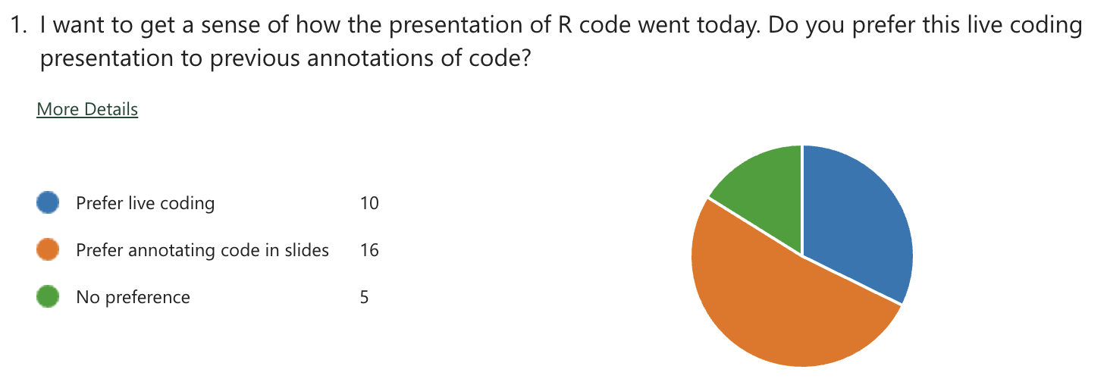
Announcements

Slide 4
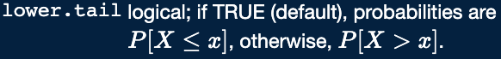
Homework 1 Redo
Question 2c: Make sure to include distribution of test statistic
This is on me
If you chose a chi-squared test statistic, what distribution does it follow?
Common mistakes
Question 5: Criteria for different tests in table
Think about the expected cell counts
How to use pbinom to calculate P(X>=x)? What does lower.tail=FALSE do?
What to include in a short summary/conclusion of results.
Usually, three things need to be covered in your conclusion:
Is your test result significant? Compare p-value or test statistic to your designated alpha or critical value
Do you reject or fail to reject the null hypothesis?
What is the overall conclusion (clinically meaningful statement)?
For the Cochran-Armitage test for trend, you can state the specific trend (decreased/increased) based on the table

Slide 5
Class 7 Learning Objective
Test the significance of estimated coefficients and create confidence interval for each using three tests (Finish up coding for Wald and LRT)
Predict the probability of “success” for an individual with specific covariate values
Interpret coefficient estimates for binary independent variables in simple logistic regression
Interpret coefficient estimates for categorial independent variables with multiple groups in simple logistic regression
Interpret coefficient estimates for continuous variables in simple logistic regression

Slide 6
Class 7 Learning Objective
Test the significance of estimated coefficients and create confidence interval for each using three tests (Finish up coding for Wald and LRT)
Predict the probability of “success” for an individual with specific covariate values
Interpret coefficient estimates for binary independent variables in simple logistic regression
Interpret coefficient estimates for categorial independent variables with multiple groups in simple logistic regression
Interpret coefficient estimates for continuous variables in simple logistic regression

Slide 7
Which test to use?
All three tests are asymptotically equivalent
As sample approaches infinity
For testing significance of single covariate coefficient:
LRT: most people’s recommendation
Wald and score are only approximations of LRT
For smaller samples, LRT better
Wald test is very convenient
Automatically performed in R
Does not need to estimate two models (LRT does)
Good for testing separate coefficients for a categorical covariate
Score test
Does not need to estimate two models (LRT does)
I don’t really see people use this…

Slide 8
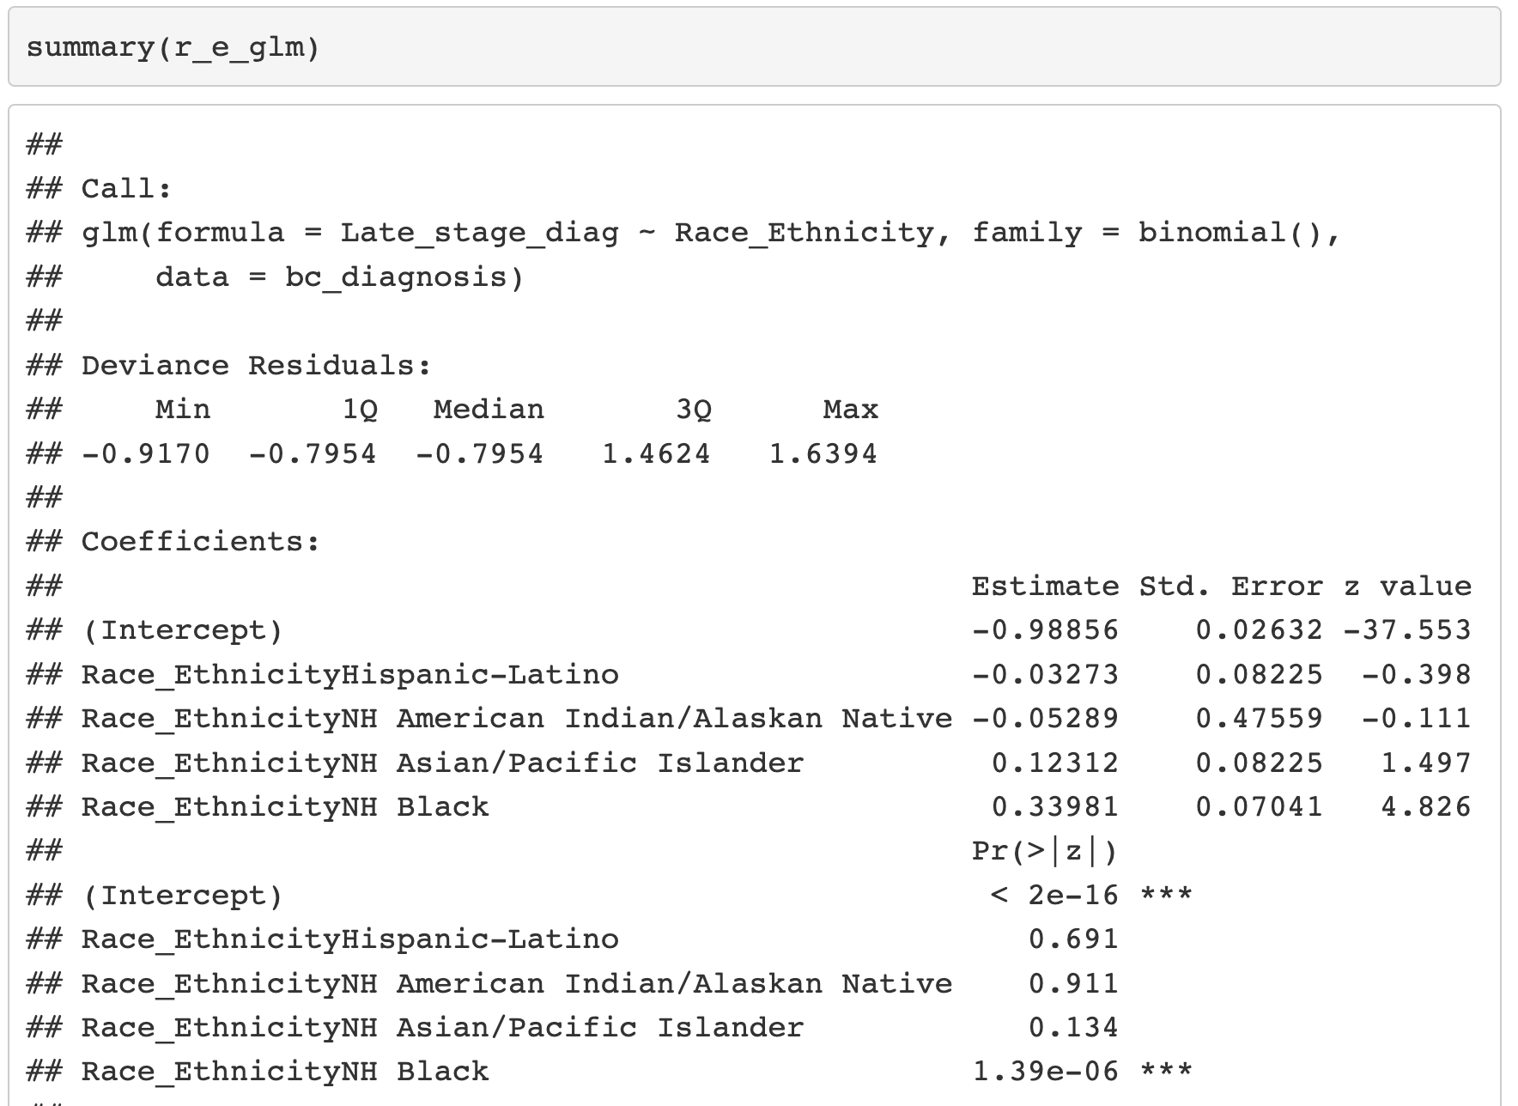

Wald Test in R

Slide 9
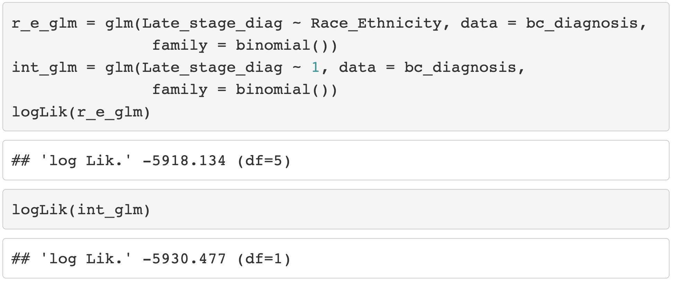
Likelihood Ratio Test in R (I)

Slide 10
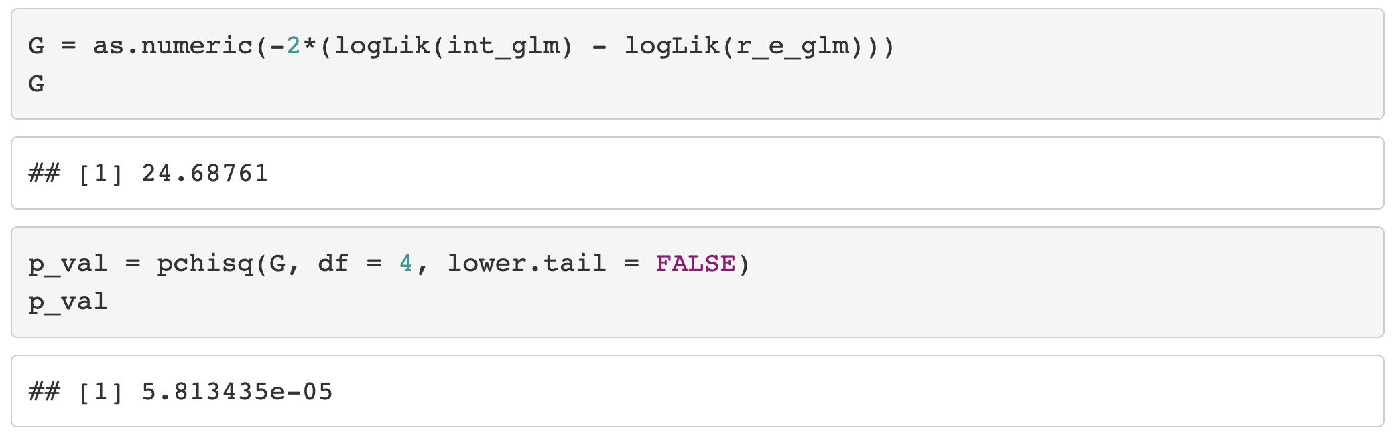
Likelihood Ratio Test in R (II)

Slide 11
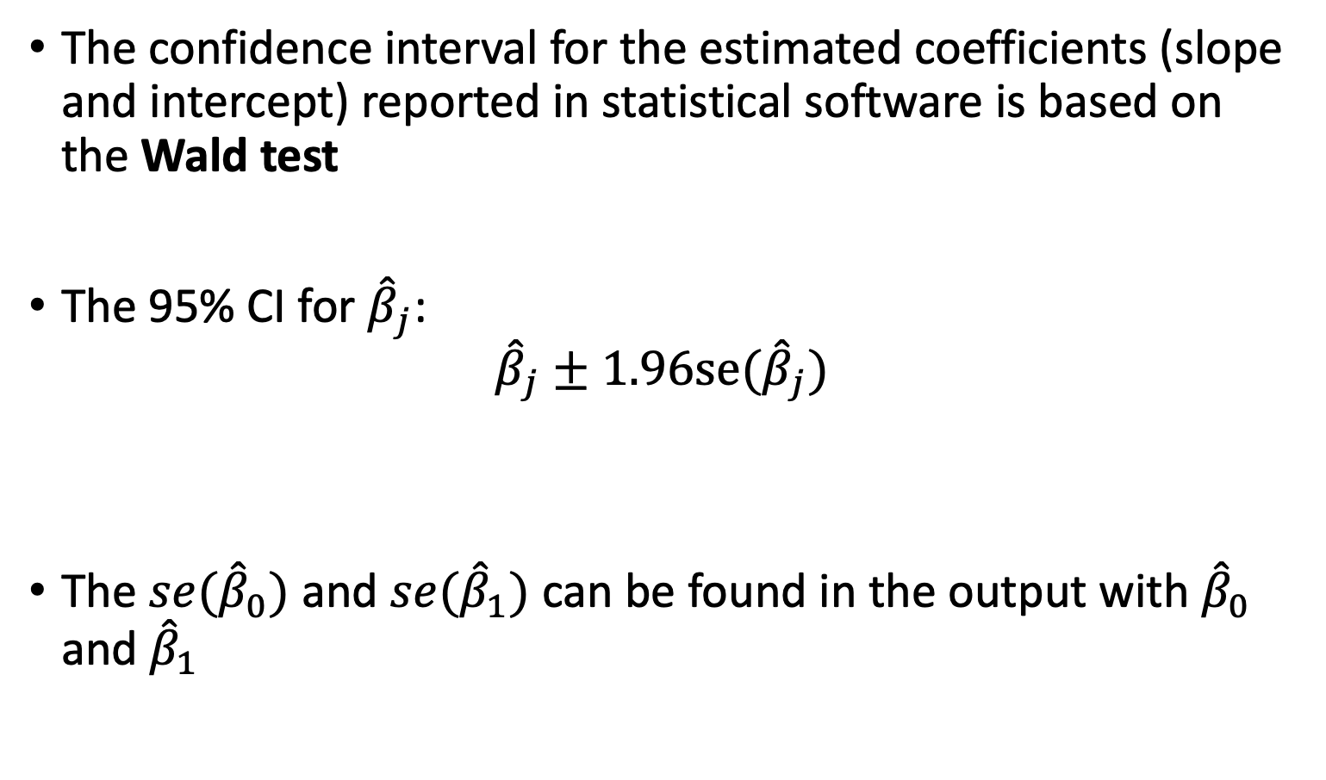
Confidence Interval for the Coefficients (I)
The confidence interval for the estimated coefficients (slope and intercept) reported in statistical software is based on the Wald test
The 95% CI for ${\hat{β}}_{j}$:
$${\hat{β}}_{j}±1.96se({\hat{β}}_{j})$$
The $se({\hat{β}}_{0})$ and $se({\hat{β}}_{1})$ can be found in the output with ${\hat{β}}_{0}$ and ${\hat{β}}_{1}$

Slide 12
Poll Everywhere Question 1

Slide 13
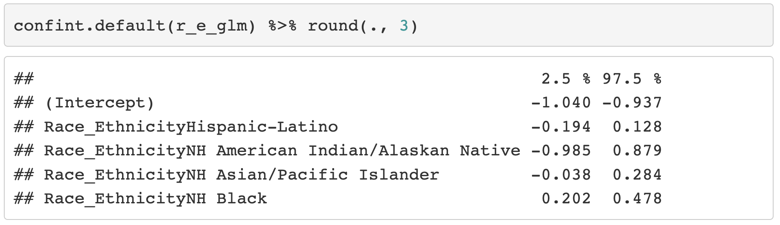
Confidence Interval for the Coefficients (II)
Note: confint() uses profile likelihood method for CI
For Wald confidence interval, should use confint.default()

Slide 14
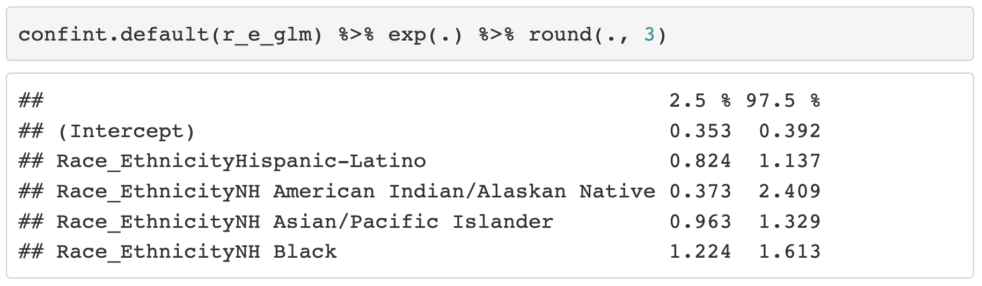
Confidence Interval for the Odds Ratio
As we saw in last class, we take the exponential of the coefficient to get the odds ratio
We can do the same for the confidence interval

Slide 15
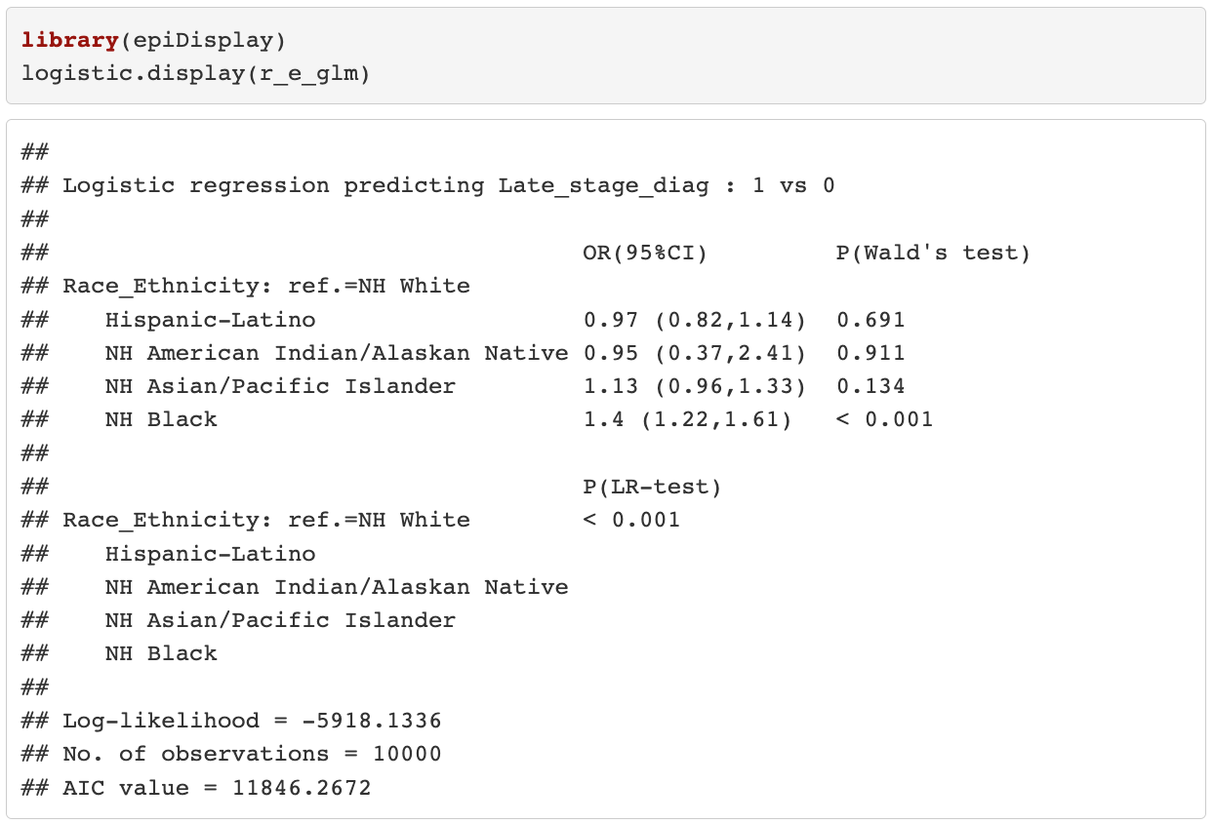
Confidence Interval for the Odds Ratio (II)
Other function for estimated odds ratios

Slide 16
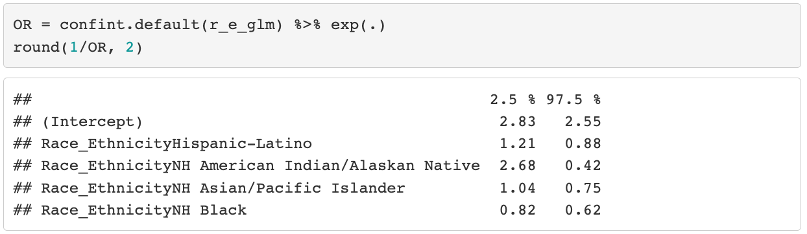
Confidence Interval for the Odds Ratio (III)
As we saw in last class, we take inverse OR
We can do the same for the confidence interval

Slide 17
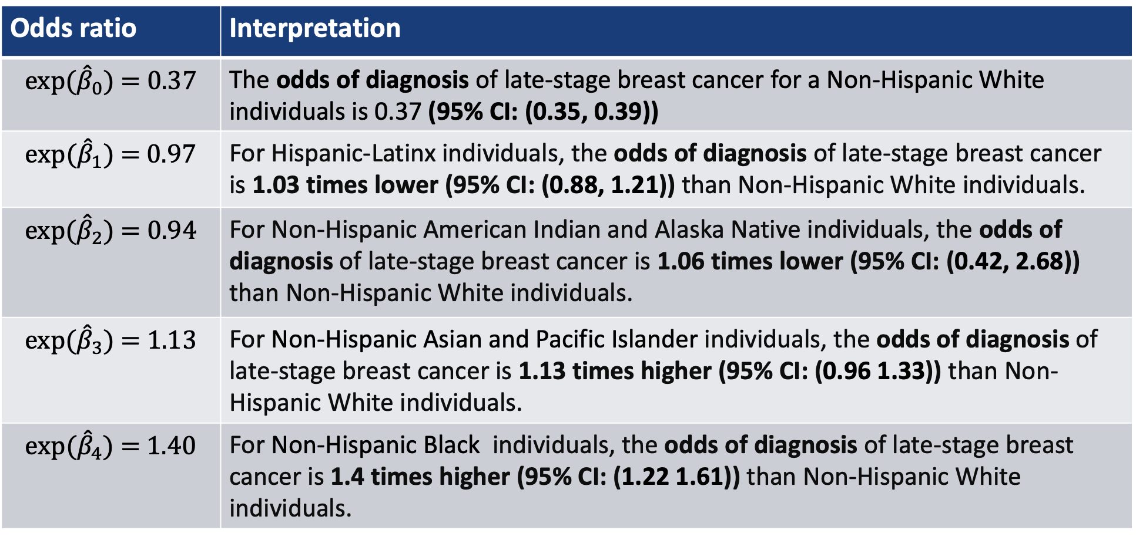
Interpretation of odds ratios (categorical covariate)
Reference
Odds ratio | Interpretation
$${exp⁡(\hat{β}}_{0})\text{ = 0.37}$$ | The odds of diagnosis of late-stage breast cancer for a Non-Hispanic White individuals is 0.37 (95% CI: (0.35, 0.39))
$${exp⁡(\hat{β}}_{1})\text{ = 0.97}$$ | For Hispanic-Latinx individuals, the odds of diagnosis of late-stage breast cancer is 1.03 times lower (95% CI: (0.88, 1.21)) than Non-Hispanic White individuals.
$${exp⁡(\hat{β}}_{2})\text{ = 0.94}$$ | For Non-Hispanic American Indian and Alaska Native individuals, the odds of diagnosis of late-stage breast cancer is 1.06 times lower (95% CI: (0.42, 2.68)) than Non-Hispanic White individuals.
$${exp⁡(\hat{β}}_{3})\text{ = 1.13}$$ | For Non-Hispanic Asian and Pacific Islander individuals, the odds of diagnosis of late-stage breast cancer is 1.13 times higher (95% CI: (0.96 1.33)) than Non-Hispanic White individuals.
$${exp⁡(\hat{β}}_{4})\text{ = 1.40}$$ | For Non-Hispanic Black individuals, the odds of diagnosis of late-stage breast cancer is 1.4 times higher (95% CI: (1.22 1.61)) than Non-Hispanic White individuals.

Slide 18
Class 7 Learning Objective
Test the significance of estimated coefficients and create confidence interval for each using three tests (Finish up coding for Wald and LRT)
Predict the probability of “success” for an individual with specific covariate values
Interpret coefficient estimates for binary independent variables in simple logistic regression
Interpret coefficient estimates for categorial independent variables with multiple groups in simple logistic regression
Interpret coefficient estimates for continuous variables in simple logistic regression

Slide 19
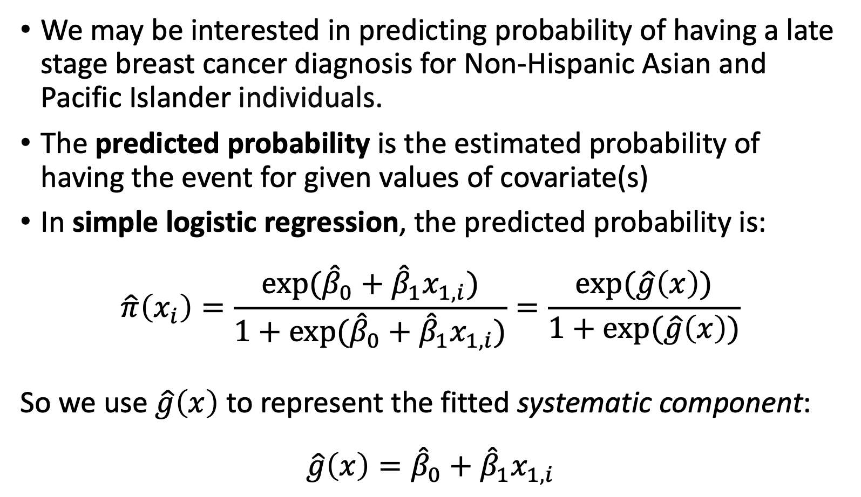
Predicted Probability (I)
We may be interested in predicting probability of having a late stage breast cancer diagnosis for Non-Hispanic Asian and Pacific Islander individuals.
The predicted probability is the estimated probability of having the event for given values of covariate(s)
In simple logistic regression, the predicted probability is:
$$\hat{π}\left(x_{i}\right)=\frac{exp⁡({\hat{β}}_{0}+{\hat{β}}_{1}x_{1,i})}{1+exp⁡({\hat{β}}_{0}+{\hat{β}}_{1}x_{1,i})}=\frac{exp⁡(\hat{g}\left(x\right))}{1+exp⁡(\hat{g}\left(x\right))}$$
So we use $\hat{g}\left(x\right)$ to represent the fitted systematic component:
$$\hat{g}\left(x\right)={\hat{β}}_{0}+{\hat{β}}_{1}x_{1,i}$$

Slide 20
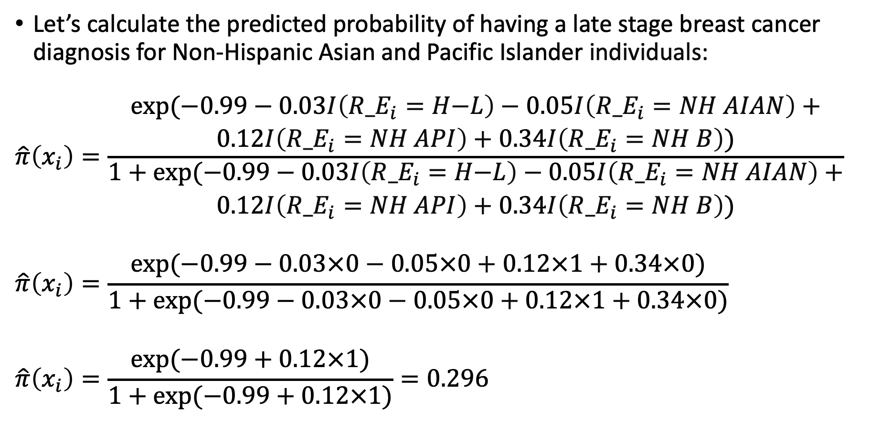
Predicted Probability (II)
Let’s calculate the predicted probability of having a late stage breast cancer diagnosis for Non-Hispanic Asian and Pacific Islander individuals:
$$\hat{π}\left(x_{i}\right)=\frac{\begin{aligned}exp⁡(\text{−}\text{0.9}9−\text{0.03}I\left({R_E}_{i}=H\text{−}L\right)−\text{0.05}I\left({R_E}_{i}=NH AIAN\right)+ \\ \text{0.12}I\left({R_E}_{i}=NH API\right)+\text{0.3}4I\left({R_E}_{i}=NH B\right))\end{aligned}}{\begin{aligned}1+exp⁡(\text{−}\text{0.9}9−\text{0.03}I\left({R_E}_{i}=H\text{−}L\right)−\text{0.05}I\left({R_E}_{i}=NH AIAN\right)+ \\ \text{0.12}I\left({R_E}_{i}=NH API\right)+\text{0.3}4I\left({R_E}_{i}=NH B\right))\end{aligned}}$$
$$\hat{π}\left(x_{i}\right)=\frac{exp⁡(\text{−}\text{0.9}9−\text{0.03}×0−\text{0.05}×0+\text{0.12}×1+\text{0.3}4×0)}{1+exp⁡(\text{−}\text{0.9}9−\text{0.03}×0−\text{0.05}×0+\text{0.12}×1+\text{0.3}4×0)}$$
$$\hat{π}\left(x_{i}\right)=\frac{exp⁡(−0.99+\text{0.12}×1)}{1+exp⁡(−0.99+\text{0.12}×1)}=0.296$$

Slide 21
Predicted Probability (III)
Predicted probability is NOT our predicted outcome
We cannot interpret it as the predicted Y for individuals with certain covariate values
Example: our predicted probability does not tell us that one individual is or is not diagnosed with late stage breast cancer
The 0.296 is the estimate of the mean (i.e., proportion) of Non-Hispanic Asian and Pacific Islander individuals who are diagnosed with late stage breast cancer

Slide 22

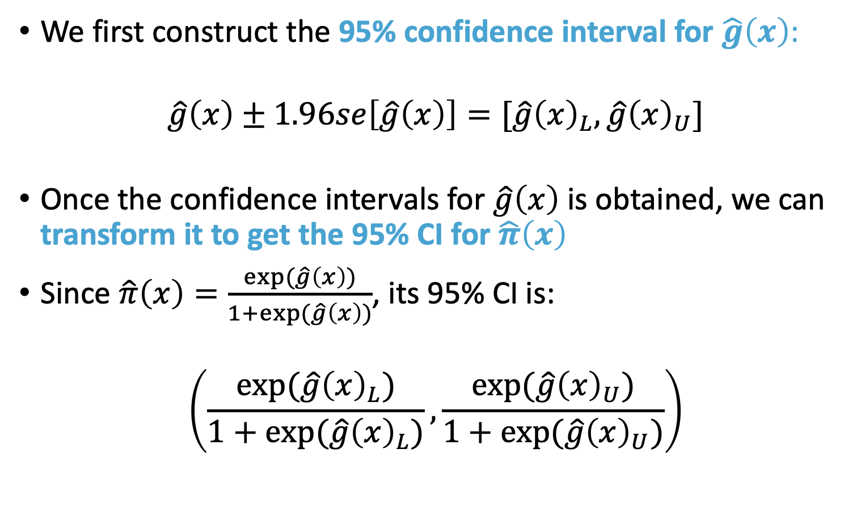
Confidence Interval for Predicted Probability (I)
We first construct the 95% confidence interval for $\hat{g}\left(x\right)$:
$$\hat{g}\left(x\right)±1.96se\left[\hat{g}\left(x\right)\right]=[\hat{g}{\left(x\right)}_{L},\hat{g}{\left(x\right)}_{U}]$$
Once the confidence intervals for $\hat{g}\left(x\right)$ is obtained, we can transform it to get the 95% CI for $\hat{π}\left(x\right)$
Since $\hat{π}\left(x\right)=\frac{exp⁡(\hat{g}\left(x\right))}{1+exp⁡(\hat{g}\left(x\right))}$, its 95% CI is:
$$\left(\frac{exp⁡(\hat{g}{\left(x\right)}_{L})}{1+exp⁡(\hat{g}{\left(x\right)}_{L})},\frac{exp⁡(\hat{g}{\left(x\right)}_{U})}{1+exp⁡(\hat{g}{\left(x\right)}_{U})}\right)$$

Slide 23
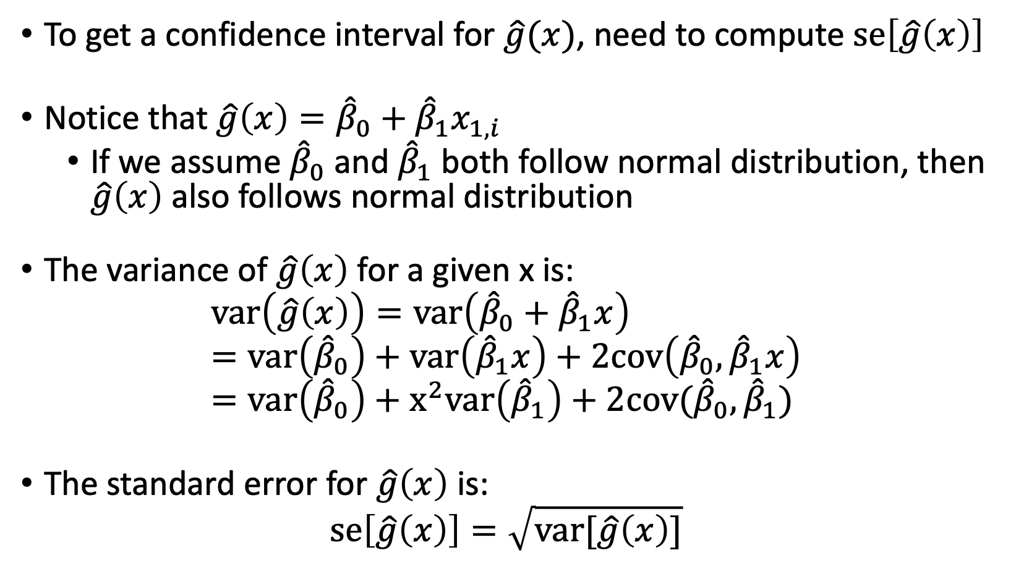
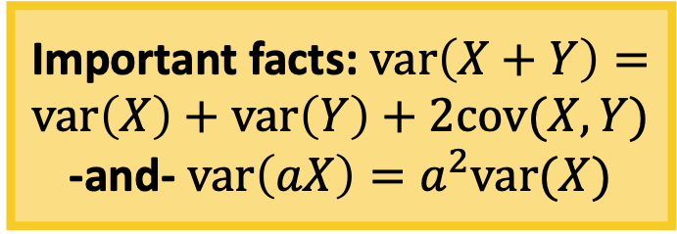
Confidence Interval for Predicted Probability (II)
To get a confidence interval for $\hat{g}(x)$, need to compute $se\left[\hat{g}\left(x\right)\right]$
Notice that $\hat{g}\left(x\right)={\hat{β}}_{0}+{\hat{β}}_{1}x_{1,i}$
If we assume ${\hat{β}}_{0}$ and ${\hat{β}}_{1}$ both follow normal distribution, then $\hat{g}\left(x\right)$ also follows normal distribution
The variance of $\hat{g}\left(x\right)$ for a given x is:
$$var\left(\hat{g}\left(x\right)\right)=var\left({\hat{β}}_{0}+{\hat{β}}_{1}x\right)=var\left({\hat{β}}_{0}\right)+var\left({\hat{β}}_{1}x\right)+2cov\left({\hat{β}}_{0},{\hat{β}}_{1}x\right)=var\left({\hat{β}}_{0}\right)+x^{2}var\left({\hat{β}}_{1}\right)+2cov({\hat{β}}_{0},{\hat{β}}_{1})$$
The standard error for $\hat{g}\left(x\right)$ is:
$$se\left[\hat{g}\left(x\right)\right]=\sqrt{var[\hat{g}\left(x\right)]}$$
Important facts: $var\left(X+Y\right)=var\left(X\right)+var\left(Y\right)+2cov(X, Y)$
-and- $var\left(aX\right)=a^{2}var(X)$

Slide 24
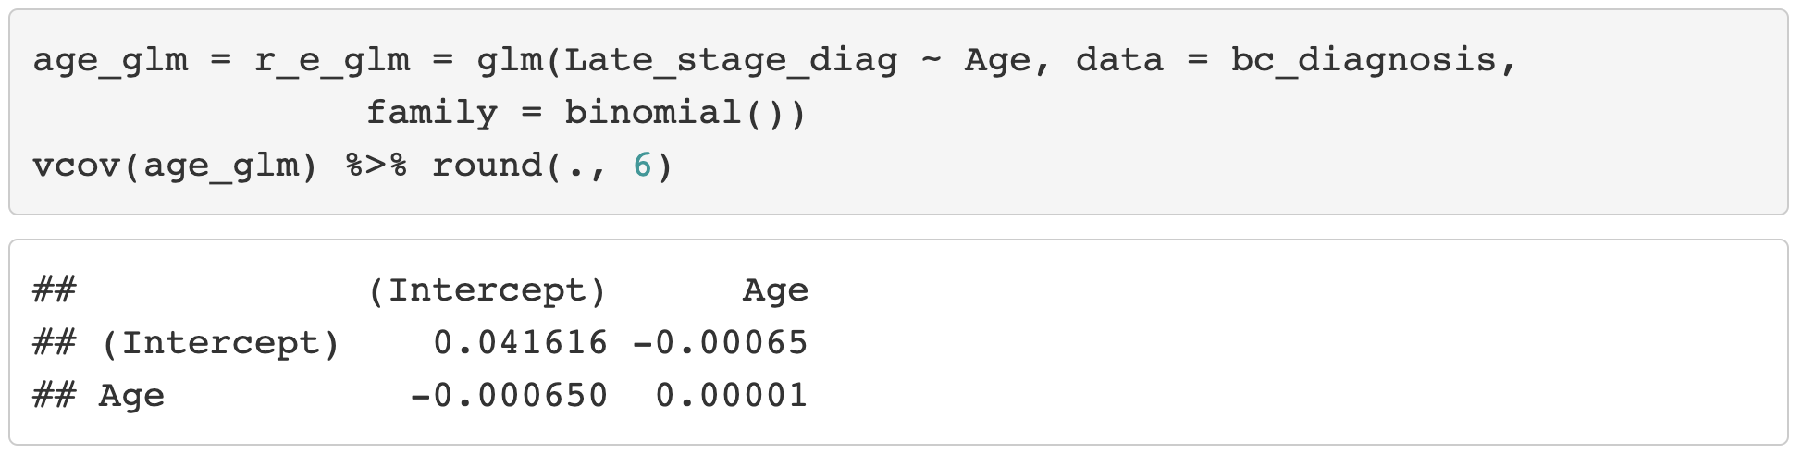

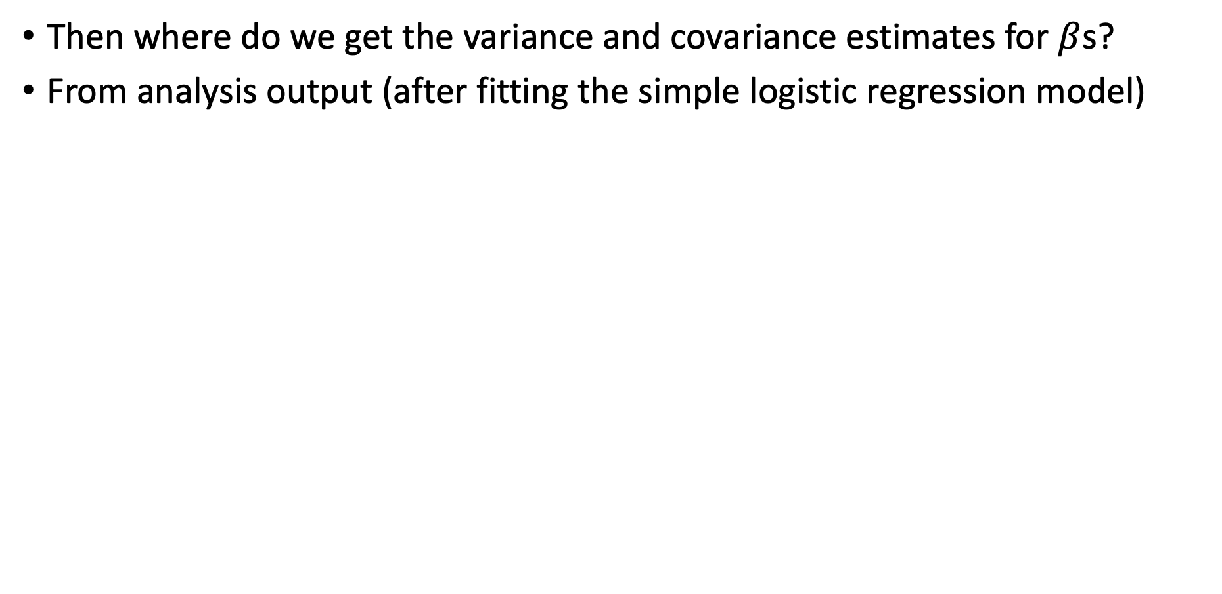


Confidence Interval for Predicted Probability (III)
Then where do we get the variance and covariance estimates for $β$s?
From analysis output (after fitting the simple logistic regression model)
$$cov({\hat{β}}_{0},{\hat{β}}_{1})$$
$$var\left({\hat{β}}_{0}\right)$$
$$var\left({\hat{β}}_{1}\right)$$

Slide 25
Poll Everywhere Question 2

Slide 26

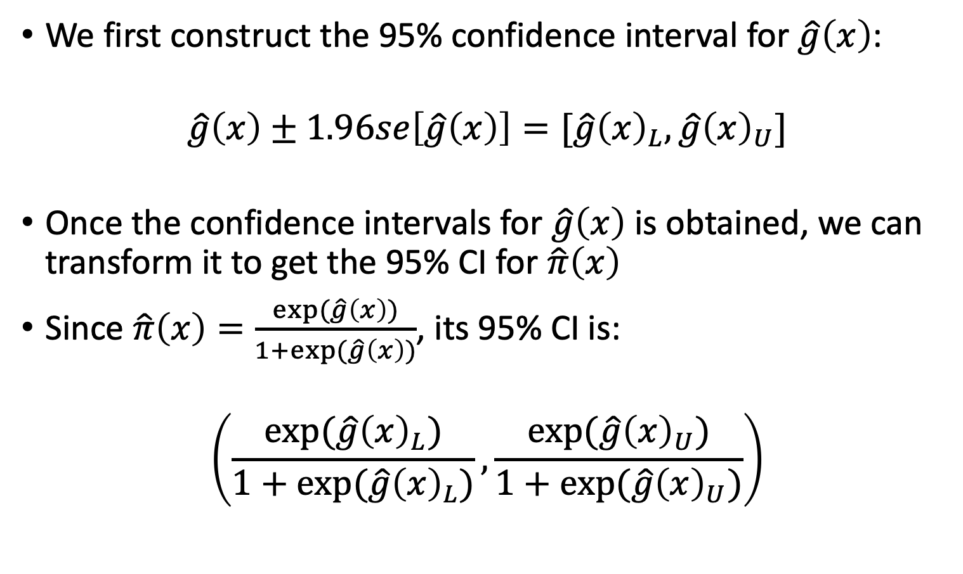
Confidence Interval for Predicted Probability (I)
We first construct the 95% confidence interval for $\hat{g}\left(x\right)$:
$$\hat{g}\left(x\right)±1.96se\left[\hat{g}\left(x\right)\right]=[\hat{g}{\left(x\right)}_{L},\hat{g}{\left(x\right)}_{U}]$$
Once the confidence intervals for $\hat{g}\left(x\right)$ is obtained, we can transform it to get the 95% CI for $\hat{π}\left(x\right)$
Since $\hat{π}\left(x\right)=\frac{exp⁡(\hat{g}\left(x\right))}{1+exp⁡(\hat{g}\left(x\right))}$, its 95% CI is:
$$\left(\frac{exp⁡(\hat{g}{\left(x\right)}_{L})}{1+exp⁡(\hat{g}{\left(x\right)}_{L})},\frac{exp⁡(\hat{g}{\left(x\right)}_{U})}{1+exp⁡(\hat{g}{\left(x\right)}_{U})}\right)$$

Slide 27
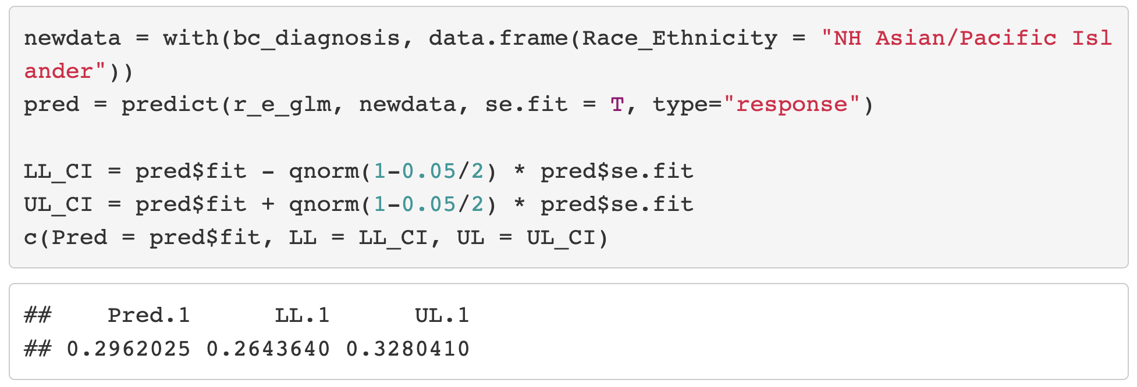
Confidence Interval for the Predicted Probability (IV)

Slide 28
Class 7 Learning Objective
Test the significance of estimated coefficients and create confidence interval for each using three tests (Finish up coding for Wald and LRT)
Predict the probability of “success” for an individual with specific covariate values
Interpret coefficient estimates for binary independent variables in simple logistic regression
Interpret coefficient estimates for categorial independent variables with multiple groups in simple logistic regression
Interpret coefficient estimates for continuous variables in simple logistic regression

Slide 29
Intro/Recap of Interpreting Fitted Model
Interpret coefficients from fitted logistic regression model
Goodness-of-fit of model should be assessed before summarizing findings
In this lecture: assume model fits data well
The interpretation of the coefficients involves two issues:
The functional relationship between the dependent variable and the independent variable (link function)
Unit of change for the independent variable
We will learn the interpretation for
Binary independent variable
Categorical independent variable with multiple groups
We looked at this for our race and ethnicity variable
Continuous independent variable

Slide 30
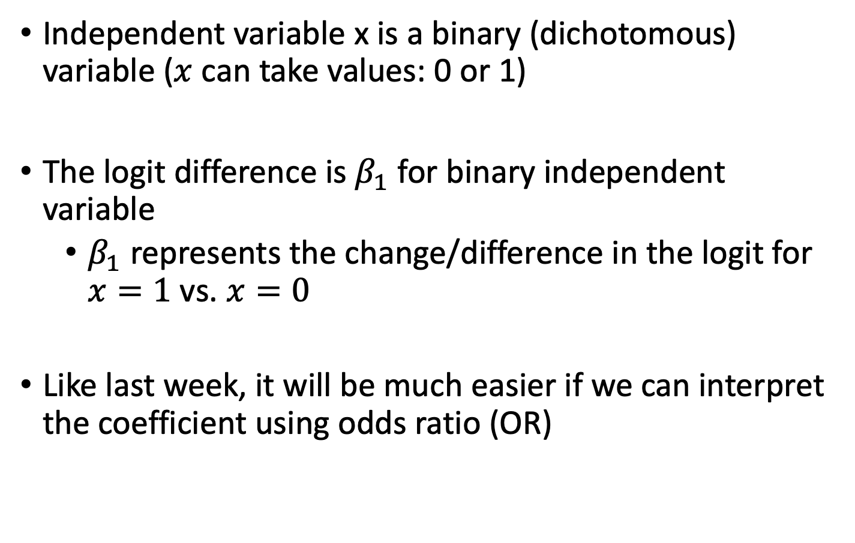
Coefficient Interpretation: Binary Independent Variable
Independent variable x is a binary (dichotomous) variable ($x$ can take values: 0 or 1)
The logit difference is $β_{1}$ for binary independent variable
$β_{1}$ represents the change/difference in the logit for $x=1$vs. $x=0$
Like last week, it will be much easier if we can interpret the coefficient using odds ratio (OR)

Slide 31
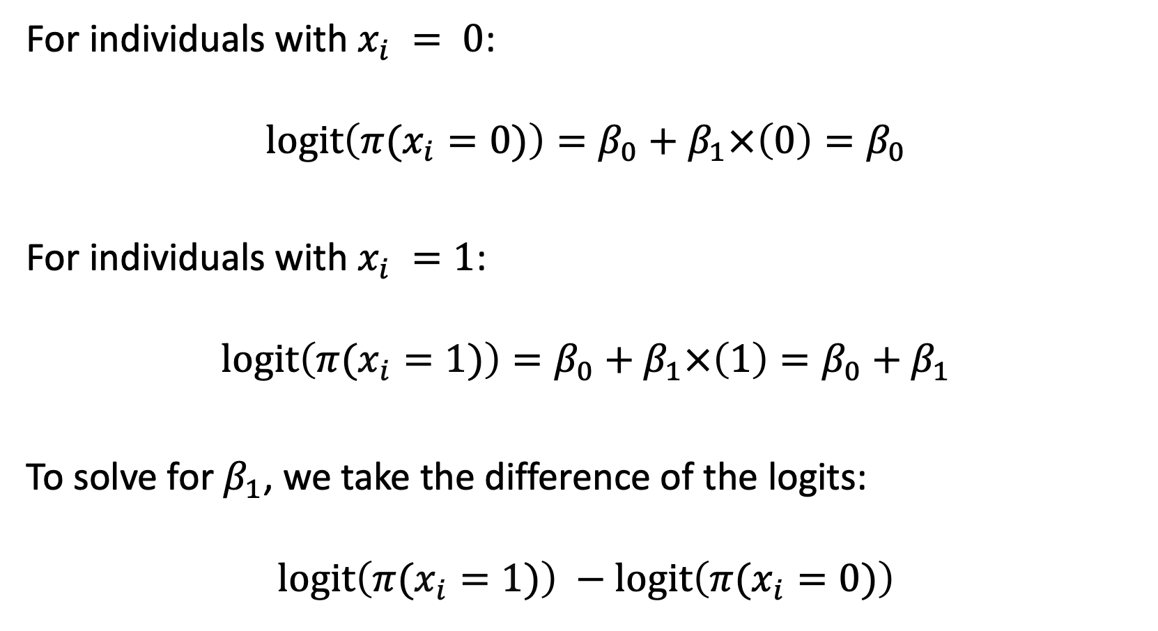
Binary: How do we interpret the coefficient? (I)
For individuals with $x_{i} = 0$:
$$l\text{ogit}\left(π(x_{i}=0)\right)=β_{0}+β_{1}×\left(0\right)=β_{0}$$
For individuals with $x_{i} =1$:
$$l\text{ogit}\left(π(x_{i}=1)\right)=β_{0}+β_{1}×\left(1\right)=β_{0}+β_{1}$$
To solve for $β_{1}$, we take the difference of the logits:
$$l\text{ogit}\left(π(x_{i}=1)\right) −l\text{ogit}\left(π(x_{i}=0)\right)$$

Slide 32
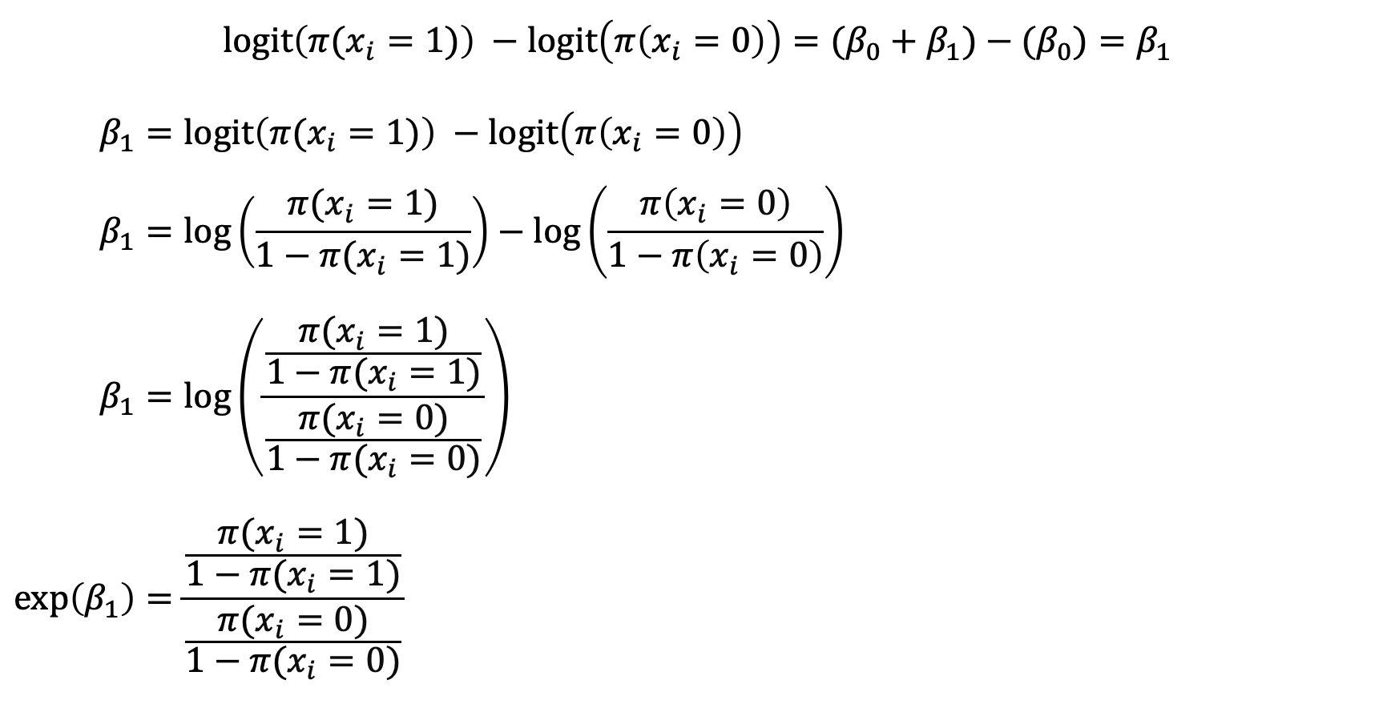
Binary: How do we interpret the coefficient? (II)
$$l\text{ogit}\left(π(x_{i}=1)\right) −l\text{ogit}\left(π\left(x_{i}=0\right)\right)={(β_{0}+β_{1})−(β}_{0})=β_{1}$$
$$β_{1}=l\text{ogit}\left(π(x_{i}=1)\right) −l\text{ogit}\left(π\left(x_{i}=0\right)\right) \\ β_{1}=l\text{og}\left(\frac{π(x_{i}=1)}{1−π(x_{i}=1)}\right)−l\text{og}\left(\frac{π\left(x_{i}=0\right)}{1−π\left(x_{i}=0\right)}\right) \\ β_{1}=\log\left(\frac{\frac{π(x_{i}=1)}{1−π(x_{i}=1)}}{\frac{π(x_{i}=0)}{1−π(x_{i}=0)}}\right) \\ \exp\left(β_{1}\right)=\frac{\frac{π(x_{i}=1)}{1−π(x_{i}=1)}}{\frac{π(x_{i}=0)}{1−π(x_{i}=0)}}$$

Slide 33
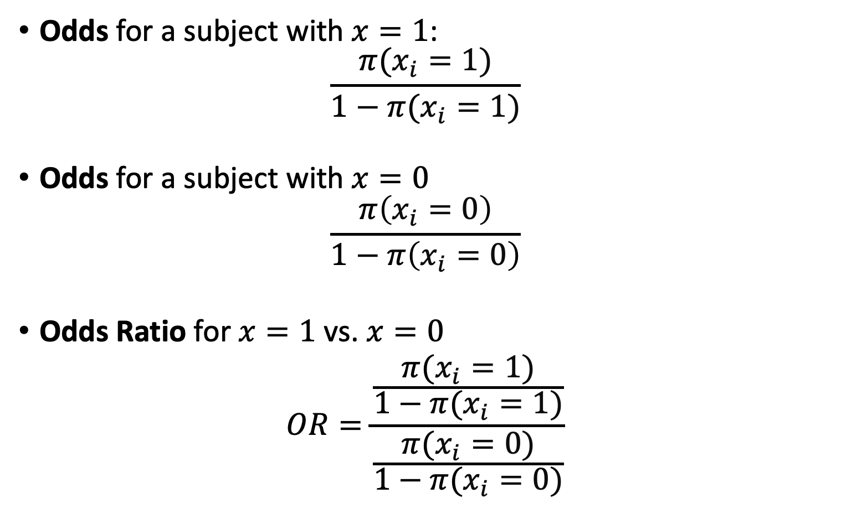
Review of Odds Ratio
Odds for a subject with $x=1$:
$$\frac{π(x_{i}=1)}{1−π(x_{i}=1)}$$
Odds for a subject with $x=0$
$$\frac{π\left(x_{i}=0\right)}{1−π\left(x_{i}=0\right)}$$
Odds Ratio for $x=1$vs. $x=0$
$$OR=\frac{\frac{π(x_{i}=1)}{1−π(x_{i}=1)}}{\frac{π(x_{i}=0)}{1−π(x_{i}=0)}}$$

Slide 34
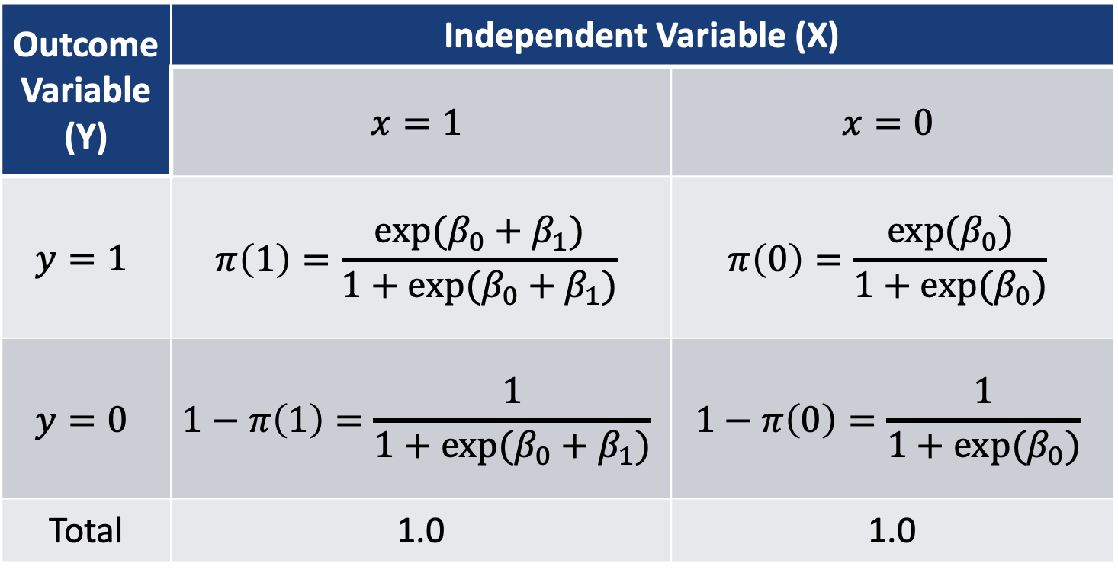
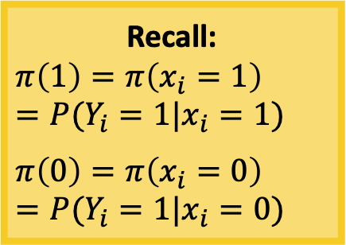
How does this relate to a 2x2 table?
Recall:
$$π\left(1\right)=π\left(x_{i}=1\right)=P(Y_{i}=1|x_{i}=1)$$
$$π\left(0\right)=π\left(x_{i}=0\right)=P(Y_{i}=1|x_{i}=0)$$
2x2 table with the respective logistic functions in each cell
Outcome Variable (Y) | Independent Variable (X)
 | $$x=1$$ | $$x=0$$
$$y=1$$ | $$π\left(1\right)=\frac{exp⁡(β_{0}+β_{1})}{1+exp⁡(β_{0}+β_{1})}$$ | $$π\left(0\right)=\frac{exp⁡(β_{0})}{1+exp⁡(β_{0})}$$
$$y=0$$ | $$1−π\left(1\right)=\frac{1}{1+exp⁡(β_{0}+β_{1})}$$ | $$1−π\left(0\right)=\frac{1}{1+exp⁡(β_{0})}$$
Total | 1.0 | 1.0
a
b
c
d

Slide 35
Poll Everywhere Question 3

Slide 36
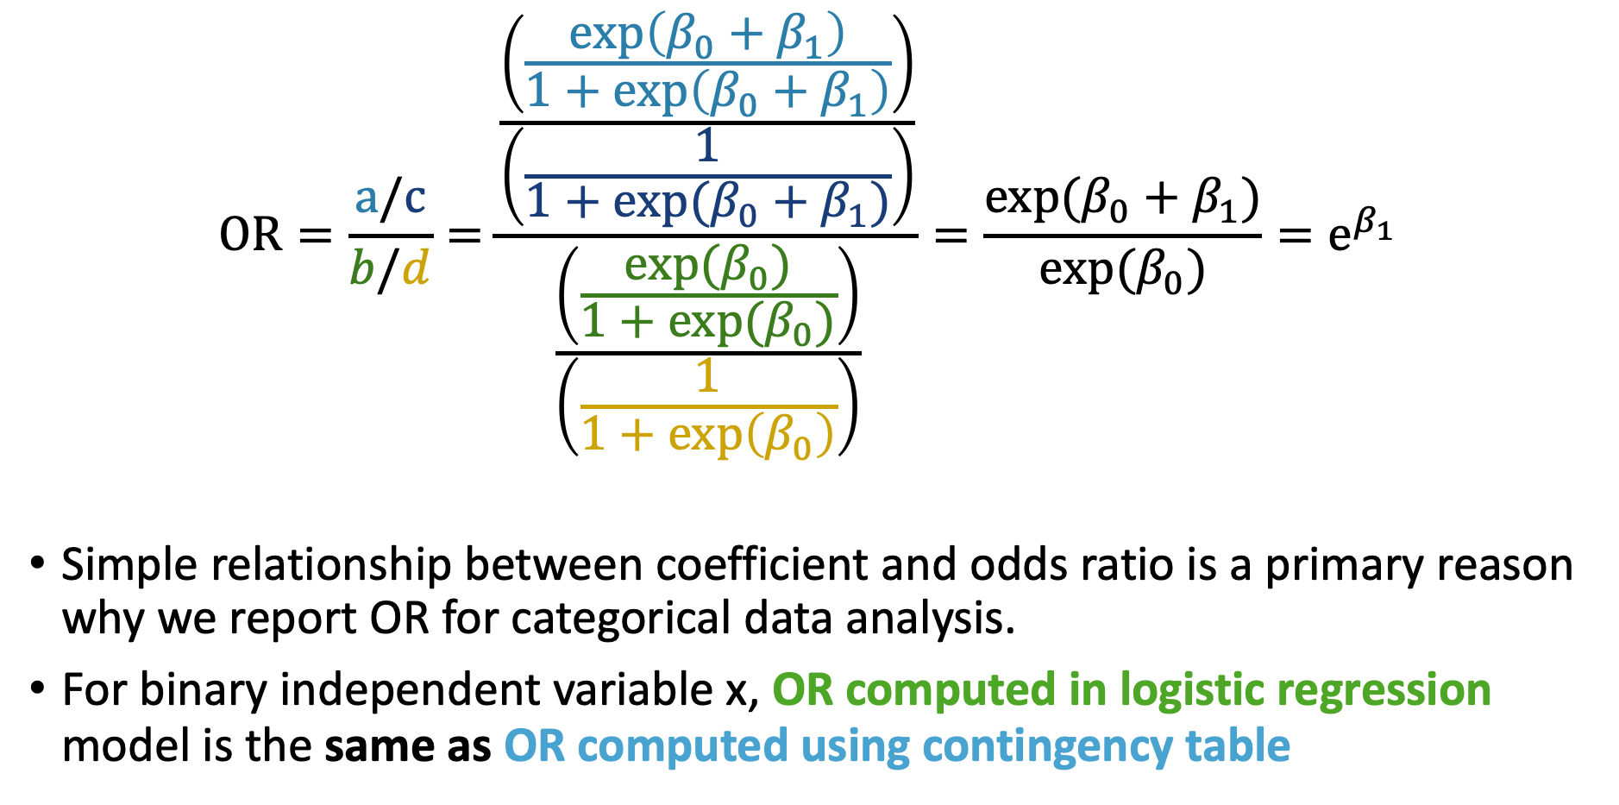
How does this relate to a 2x2 table?
$$OR=\frac{a/c}{b/d}=\frac{\frac{\left(\frac{\exp\left(β_{0}+β_{1}\right)}{1+\exp\left(β_{0}+β_{1}\right)}\right)}{\left(\frac{1}{1+exp⁡(β_{0}+β_{1})}\right)}}{\frac{\left(\frac{exp⁡(β_{0})}{1+exp⁡(β_{0})}\right)}{\left(\frac{1}{1+\exp\left(β_{0}\right)}\right)}}=\frac{exp(β_{0}+β_{1})}{exp⁡(β_{0})}=e^{β_{1}}$$
Simple relationship between coefficient and odds ratio is a primary reason why we report OR for categorical data analysis.
For binary independent variable x, OR computed in logistic regression model is the same as OR computed using contingency table

Slide 37
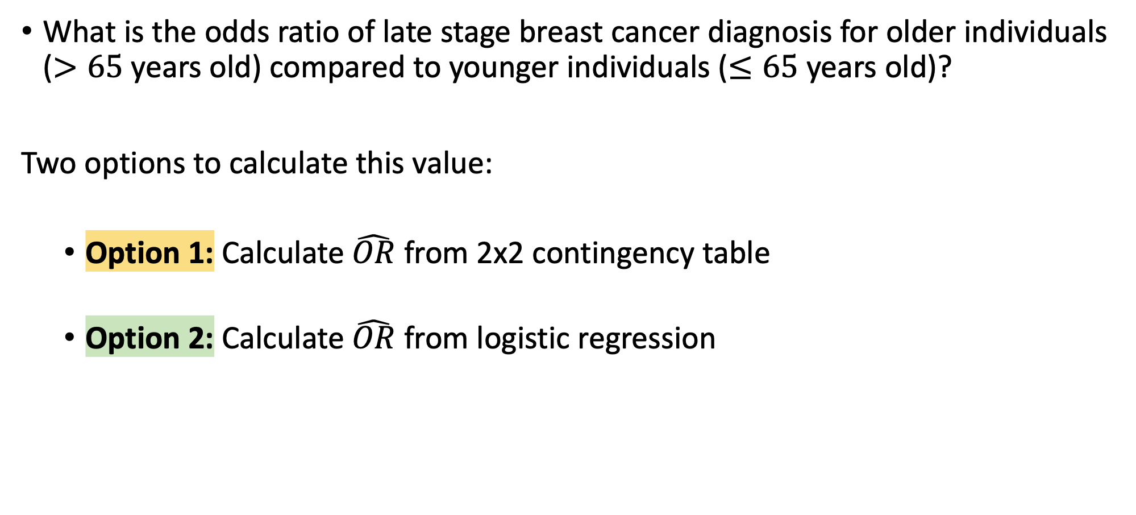
Example: Binary age and Late Stage Diagnosis (I)
What is the odds ratio of late stage breast cancer diagnosis for older individuals ($>65$ years old) compared to younger individuals ($≤65$ years old)?
Two options to calculate this value:
Option 1: Calculate $\hat{OR}$ from 2x2 contingency table
Option 2: Calculate $\hat{OR}$ from logistic regression

Slide 38
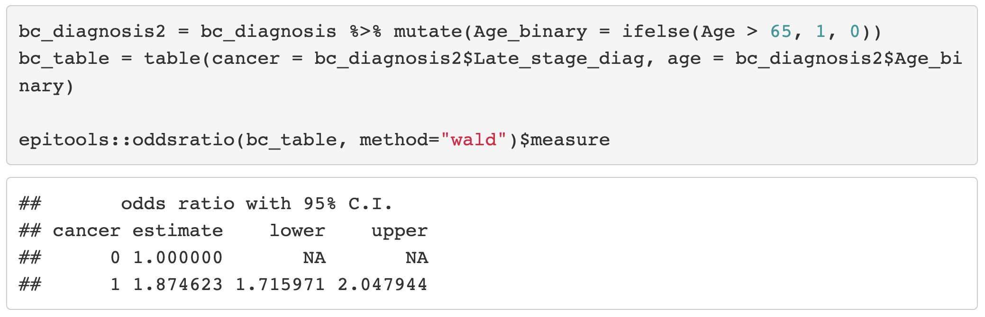
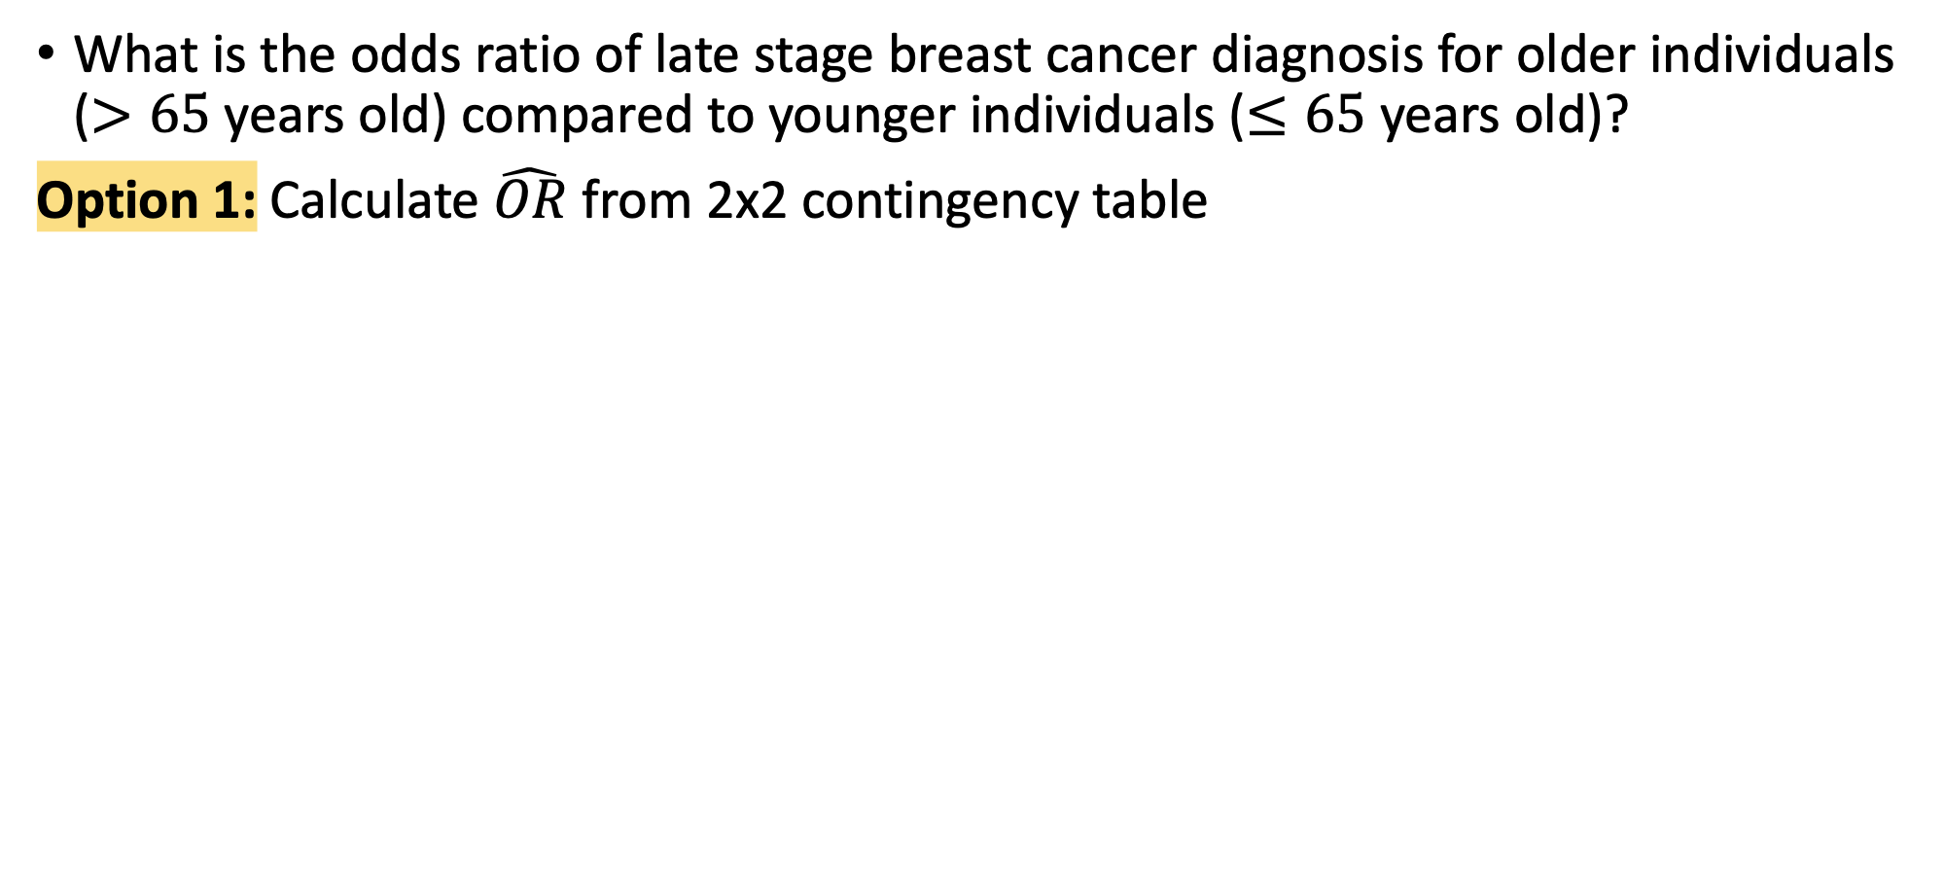
Example: Binary age and Late Stage Diagnosis (II)
What is the odds ratio of late stage breast cancer diagnosis for older individuals ($>65$ years old) compared to younger individuals ($≤65$ years old)?
Option 1: Calculate $\hat{OR}$ from 2x2 contingency table

Slide 39
Example: Binary age and Late Stage Diagnosis (II)
What is the odds ratio of late stage breast cancer diagnosis for older individuals ($>65$ years old) compared to younger individuals ($≤65$ years old)?
Option 1: Calculate $\hat{OR}$ from 2x2 contingency table

Slide 40
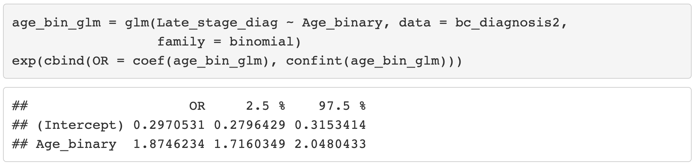
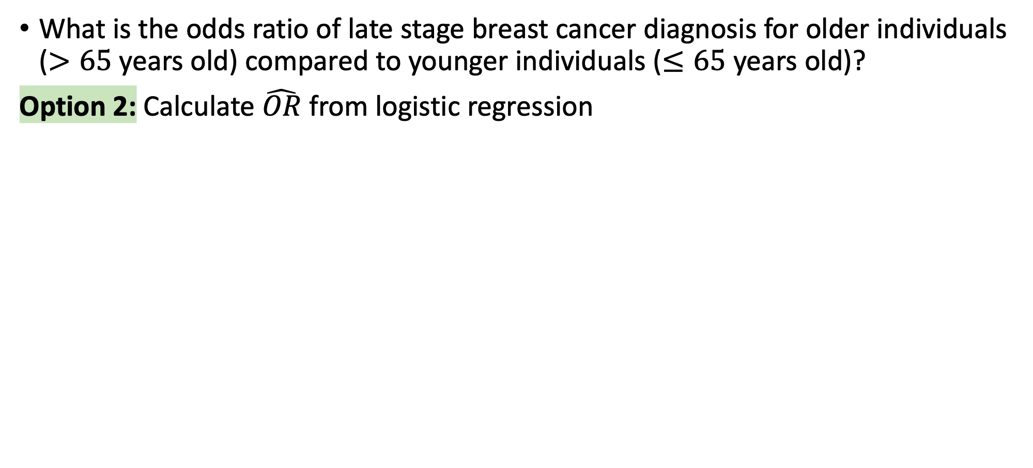
Example: Binary age and Late Stage Diagnosis (III)
What is the odds ratio of late stage breast cancer diagnosis for older individuals ($>65$ years old) compared to younger individuals ($≤65$ years old)?
Option 2: Calculate $\hat{OR}$ from logistic regression

Slide 41
Example: Binary age and Late Stage Diagnosis (III)
What is the odds ratio of late stage breast cancer diagnosis for older individuals ($>65$ years old) compared to younger individuals ($≤65$ years old)?
Option 2: Calculate $\hat{OR}$ from logistic regression

Slide 42
Poll Everywhere Question 4

Slide 43
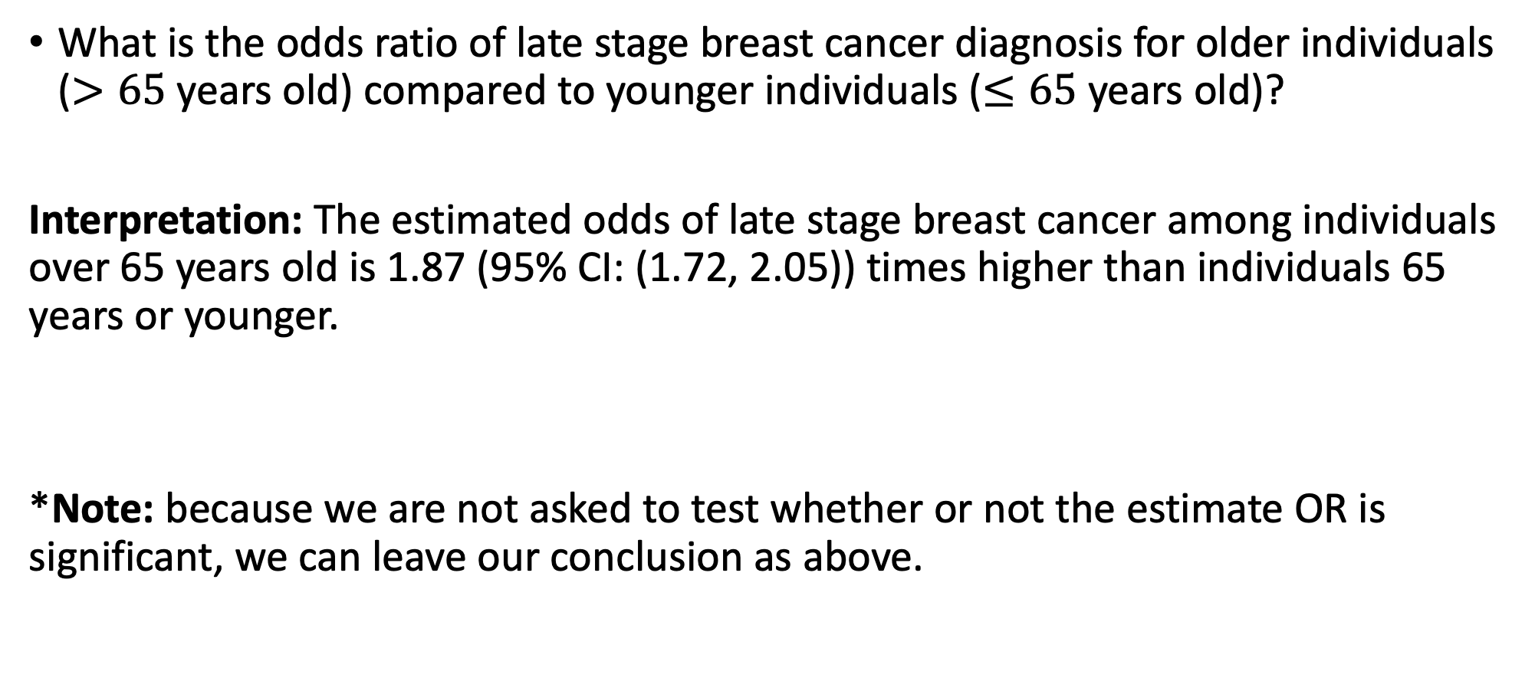
Example: Binary age and Late Stage Diagnosis (I)
What is the odds ratio of late stage breast cancer diagnosis for older individuals ($>65$ years old) compared to younger individuals ($≤65$ years old)?
Interpretation: The estimated odds of late stage breast cancer among individuals over 65 years old is 1.87 (95% CI: (1.72, 2.05)) times higher than individuals 65 years or younger.
*Note: because we are not asked to test whether or not the estimate OR is significant, we can leave our conclusion as above.

Slide 44
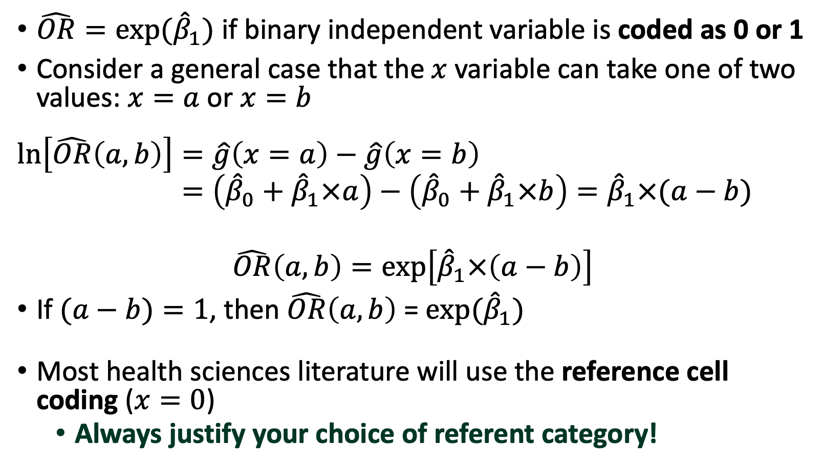
Computing OR from $β$ (I)
$\hat{OR}=exp⁡({\hat{β}}_{1})$ if binary independent variable is coded as 0 or 1
Consider a general case that the$x$variable can take one of two values: $x=a$or $x=b$
$$\ln\left[\hat{OR}\left(a,b\right)\right]=\hat{g}\left(x=a\right)−\hat{g}\left(x=b\right) \\ =\left({\hat{β}}_{0}+{\hat{β}}_{1}×a\right)−\left({\hat{β}}_{0}+{\hat{β}}_{1}×b\right)={\hat{β}}_{1}×(a−b)$$
$$\hat{OR}\left(a,b\right)=exp\left[{\hat{β}}_{1}×\left(a−b\right)\right]$$
If $(a−b)=1$, then $\hat{OR}\left(a,b\right)$ = $exp⁡({\hat{β}}_{1})$
Most health sciences literature will use the reference cell coding ($x=0$)
Always justify your choice of referent category!

Slide 45
Class 7 Learning Objective
Test the significance of estimated coefficients and create confidence interval for each using three tests (Finish up coding for Wald and LRT)
Predict the probability of “success” for an individual with specific covariate values
Interpret coefficient estimates for binary independent variables in simple logistic regression
Interpret coefficient estimates for categorial independent variables with multiple groups in simple logistic regression
Interpret coefficient estimates for continuous variables in simple logistic regression

Slide 46
Coefficient Interpretation: Multi-group Categorical Variable
Categorical variable with more than two categories
We discussed this in Class 5, Slides 42-54
How to pick the reference group?
 | Breast Cancer Diagnosis
Race/Ethnicity | Early Stage | Late Stage | Total
Non-Hispanic White | 5,321 | 1,980 | 7,301
Non-Hispanic Black | 683 | 357 | 1,040
Non-Hispanic Asian/Pacific Islander | 556 | 234 | 790
Hispanic-Latinx | 575 | 271 | 846
Non-Hispanic American Indian/Alaska Native | 17 | 6 | 23
Total | 7,152 | 2,848 | 10,000

Slide 47
How do we pick the reference group?
The choice can be more apparent for multi-group categorical independent variables within studies
For example, if we want to evaluate the association between clinical response and four treatments.
The treatment variable has 4 categories: “active treatment A”, “active treatment B”, “active treatment C” and “Placebo treatment”
The investigator is interested in comparing each of the three active treatment with the placebo treatment
Then the placebo treatment should be picked as the reference group

Slide 48
Example: Late stage diagnosis and race and ethnicity
Chose Non-Hispanic White individuals as reference group
Rooted in underlying health disparities linked to racism
There is evidence that white individuals receive a certain standard of care
 | Breast Cancer Diagnosis
Race/Ethnicity | Early Stage | Late Stage | Total
Non-Hispanic White | 5,321 | 1,980 | 7,301
Non-Hispanic Black | 683 | 357 | 1,040
Non-Hispanic Asian/Pacific Islander | 556 | 234 | 790
Hispanic-Latinx | 575 | 271 | 846
Non-Hispanic American Indian/Alaska Native | 17 | 6 | 23
Total | 7,152 | 2,848 | 10,000
https://www.ncbi.nlm.nih.gov/pmc/articles/PMC6941147/
https://www.nature.com/articles/s41572-021-00258-1

Slide 49
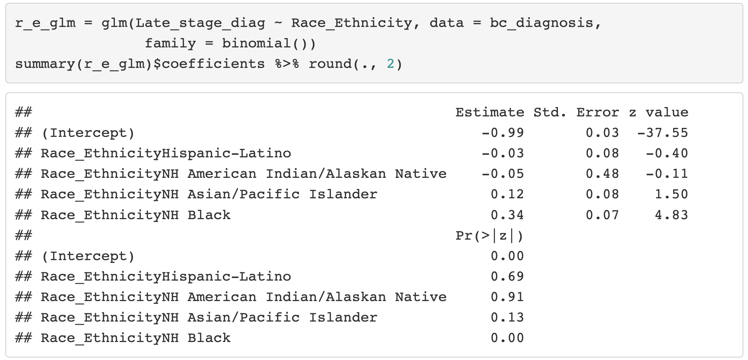
Example: Late stage diagnosis and race and ethnicity

Slide 50
Example: Late stage diagnosis and race and ethnicity

Slide 51
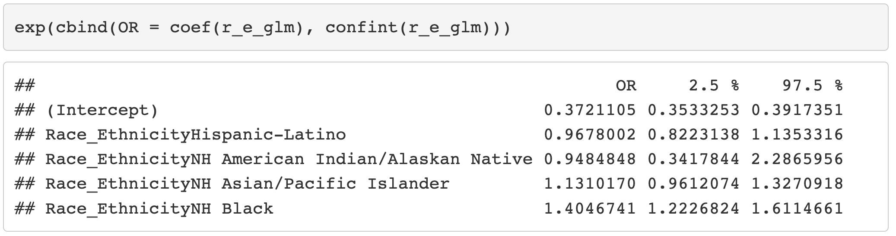
Example: Late stage diagnosis and race and ethnicity
Let’s convert to estimate OR with the confidence interval

Slide 52
Example: Late stage diagnosis and race and ethnicity
Let’s convert to estimate OR with the confidence interval

Slide 53
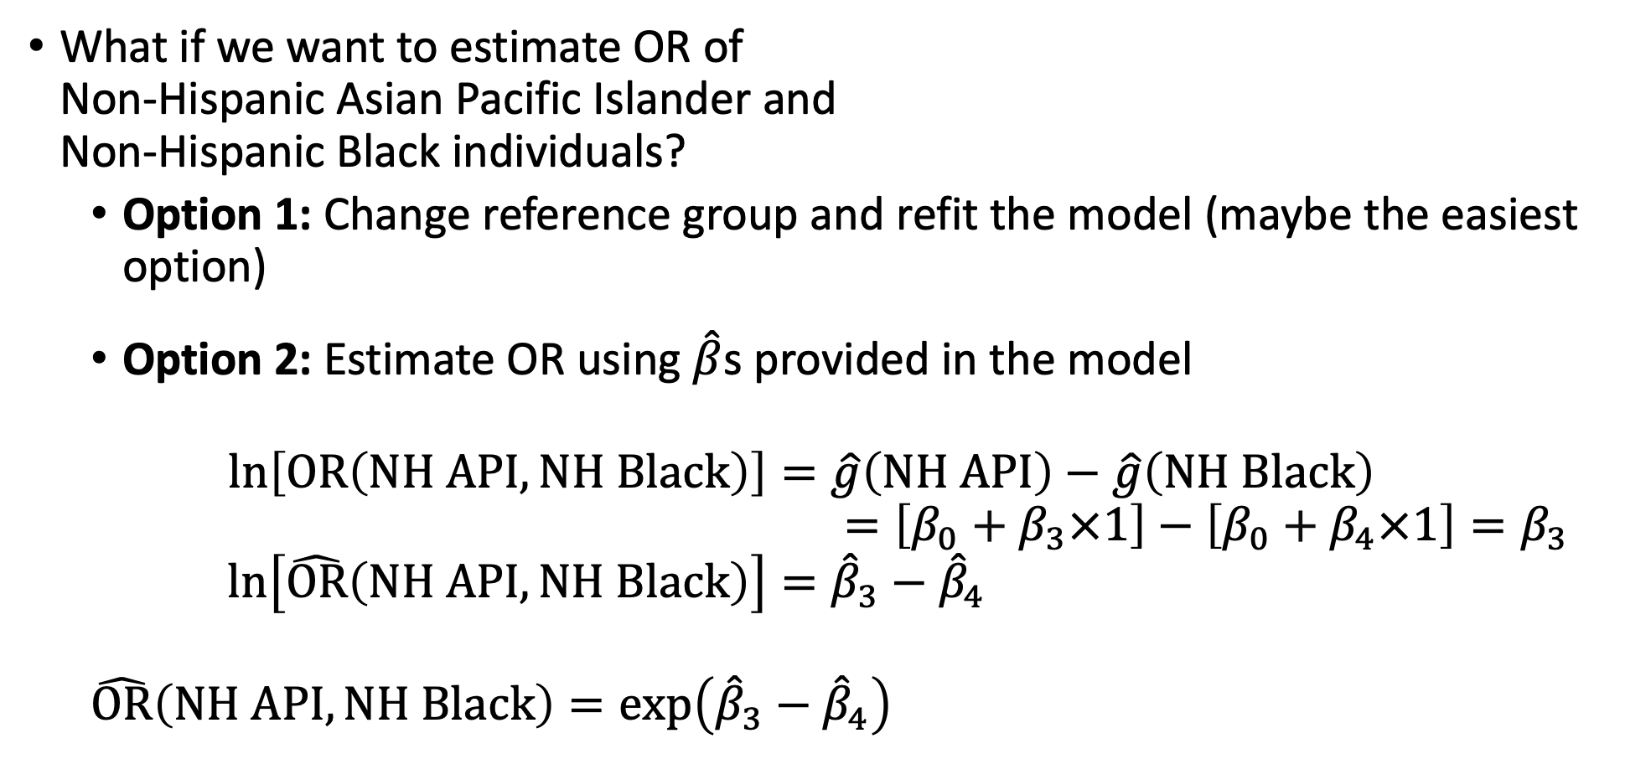
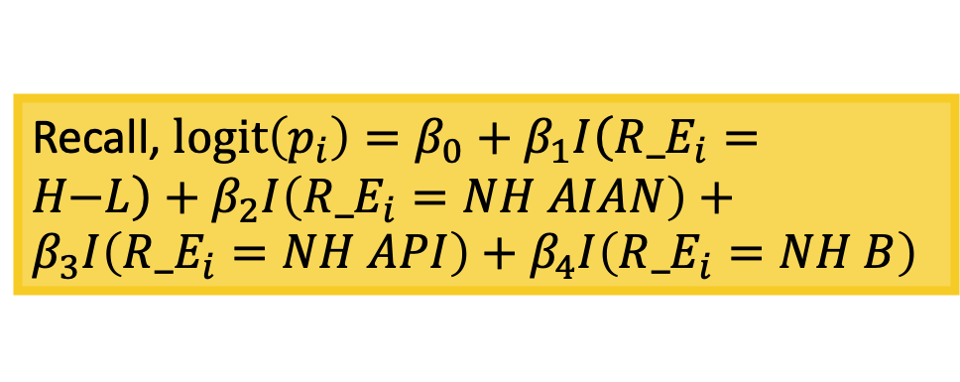
What if you want to compare other groups?
Recall, $l\text{ogit}\left(p_{i}\right)=β_{0}+β_{1}I\left({R_E}_{i}=H\text{−}L\right)+β_{2}I\left({R_E}_{i}=NH AIAN\right)+β_{3}I\left({R_E}_{i}=NH API\right)+β_{4}I\left({R_E}_{i}=NH B\right)$
What if we want to estimate OR of Non-Hispanic Asian Pacific Islander and Non-Hispanic Black individuals?
Option 1: Change reference group and refit the model (maybe the easiest option)
Option 2: Estimate OR using $\hat{β}$s provided in the model
$$\ln\left[OR\left(NH API, NH Black\right)\right]=\hat{g}\left(NH API\right)−\hat{g}\left(NH Black\right) \\ =\left[β_{0}+β_{3}×1\right]−\left[β_{0}+β_{4}×1\right]=β_{3}−β_{4} \\ \ln\left[\hat{OR}\left(NH API, NH Black\right)\right]={\hat{β}}_{3}−{\hat{β}}_{4}$$
$$\hat{OR}\left(NH API, NH Black\right)=exp\left({\hat{β}}_{3}−{\hat{β}}_{4}\right)$$

Slide 54
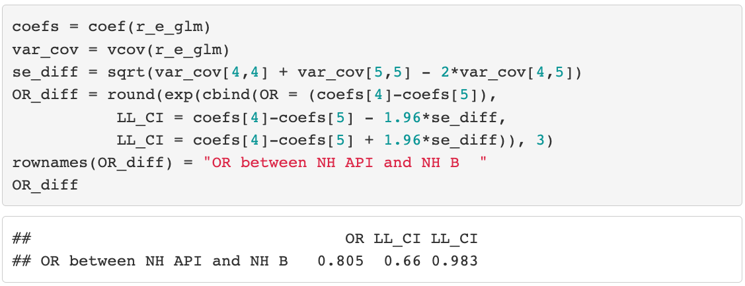
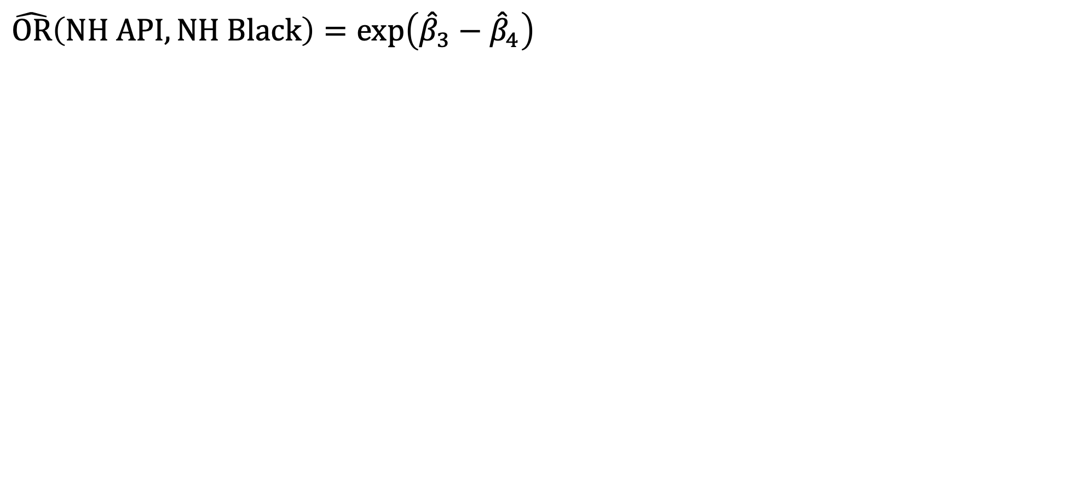
What if you want to compare other groups?
$$\hat{OR}\left(NH API, NH Black\right)=exp\left({\hat{β}}_{3}−{\hat{β}}_{4}\right)$$

Slide 55
What if you want to compare other groups?
$$\hat{OR}\left(NH API, NH Black\right)=exp\left({\hat{β}}_{3}−{\hat{β}}_{4}\right)$$

Slide 56
Poll Everywhere Question 5

Slide 57
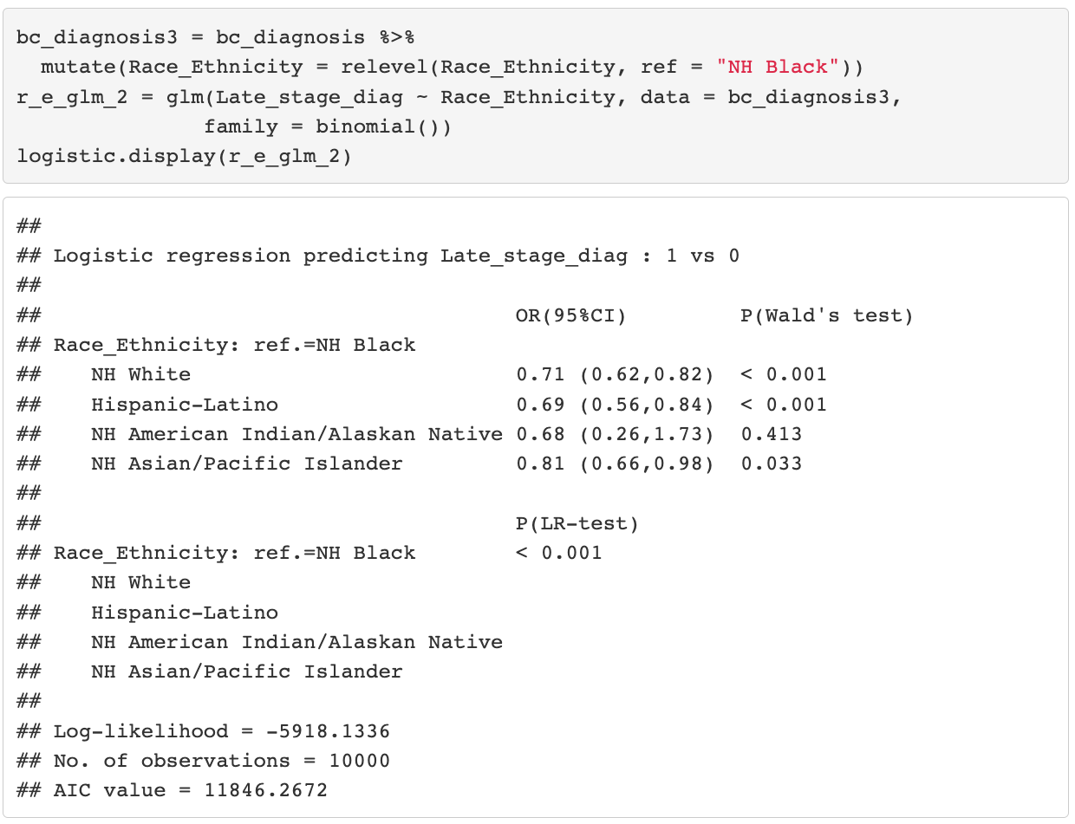
Poll Everywhere Question 5

Slide 58
Class 7 Learning Objective
Test the significance of estimated coefficients and create confidence interval for each using three tests (Finish up coding for Wald and LRT)
Predict the probability of “success” for an individual with specific covariate values
Interpret coefficient estimates for binary independent variables in simple logistic regression
Interpret coefficient estimates for categorial independent variables with multiple groups in simple logistic regression
Interpret coefficient estimates for continuous variables in simple logistic regression

Slide 59
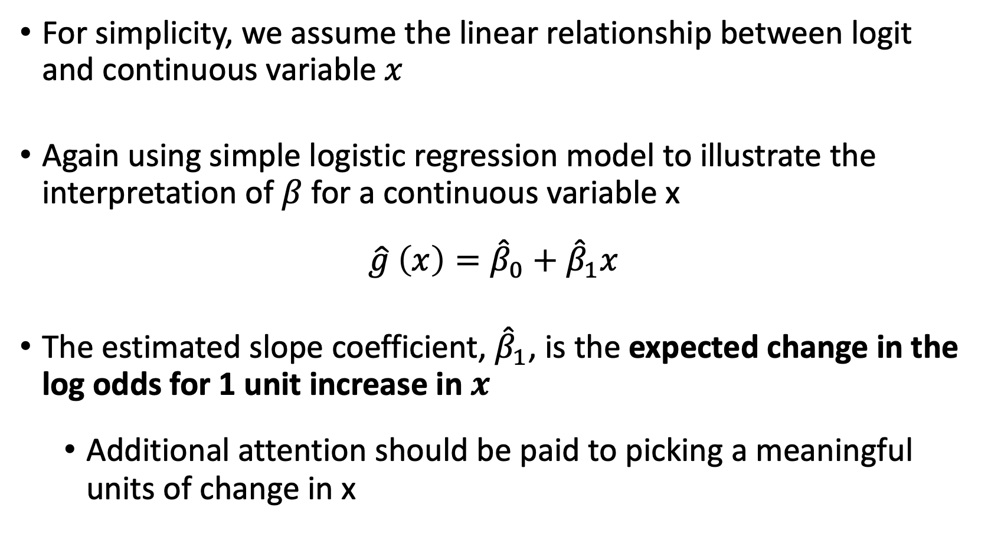
Coefficient Interpretation: Continuous Independent Variable (I)
For simplicity, we assume the linear relationship between logit and continuous variable $x$
Again using simple logistic regression model to illustrate the interpretation of $β$ for a continuous variable x
$$\hat{g} \left(x\right)={\hat{β}}_{0}+{\hat{β}}_{1}x$$
The estimated slope coefficient, ${\hat{β}}_{1}$, is the expected change in the log odds for 1 unit increase in $x$
Additional attention should be paid to picking a meaningful units of change in x

Slide 60
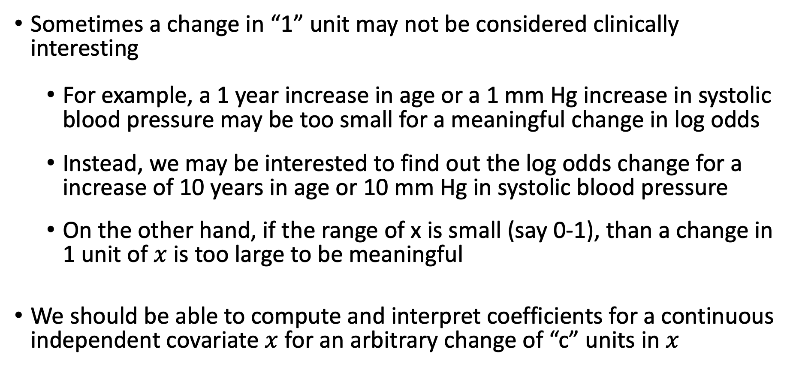
Coefficient Interpretation: Continuous Independent Variable (II)
Sometimes a change in “1” unit may not be considered clinically interesting
For example, a 1 year increase in age or a 1 mm Hg increase in systolic blood pressure may be too small for a meaningful change in log odds
Instead, we may be interested to find out the log odds change for a increase of 10 years in age or 10 mm Hg in systolic blood pressure
On the other hand, if the range of x is small (say 0-1), than a change in 1 unit of $x$ is too large to be meaningful
We should be able to compute and interpret coefficients for a continuous independent covariate $x$ for an arbitrary change of “c” units in $x$
Notes:
mm Hg reads millimeter of mercury

Slide 61
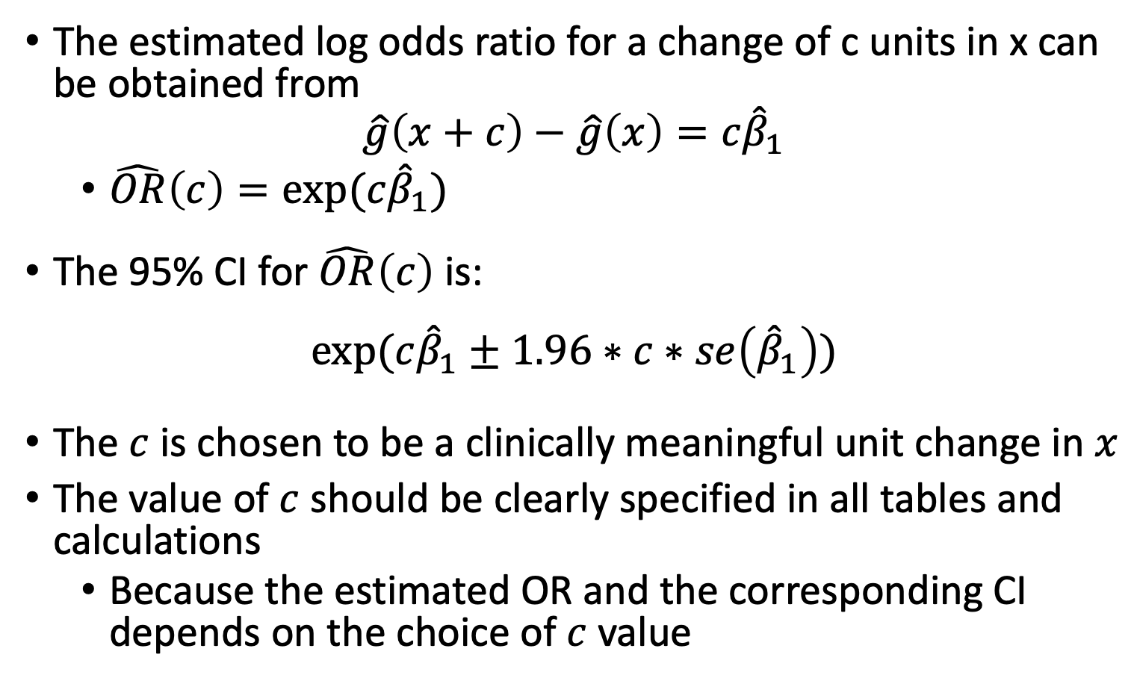
Coefficient Interpretation: Continuous Independent Variable (III)
The estimated log odds ratio for a change of c units in x can be obtained from
$$\hat{g}\left(x+c\right)−\hat{g}\left(x\right)=c{\hat{β}}_{1}$$
$\hat{OR}\left(c\right)=exp⁡(c{\hat{β}}_{1})$
The 95% CI for $\hat{OR}\left(c\right)$ is:
$$exp⁡(c{\hat{β}}_{1}±1.96∗c∗se\left({\hat{β}}_{1}\right))$$
The $c$ is chosen to be a clinically meaningful unit change in $x$
The value of $c$ should be clearly specified in all tables and calculations
Because the estimated OR and the corresponding CI depends on the choice of $c$ value

Slide 62
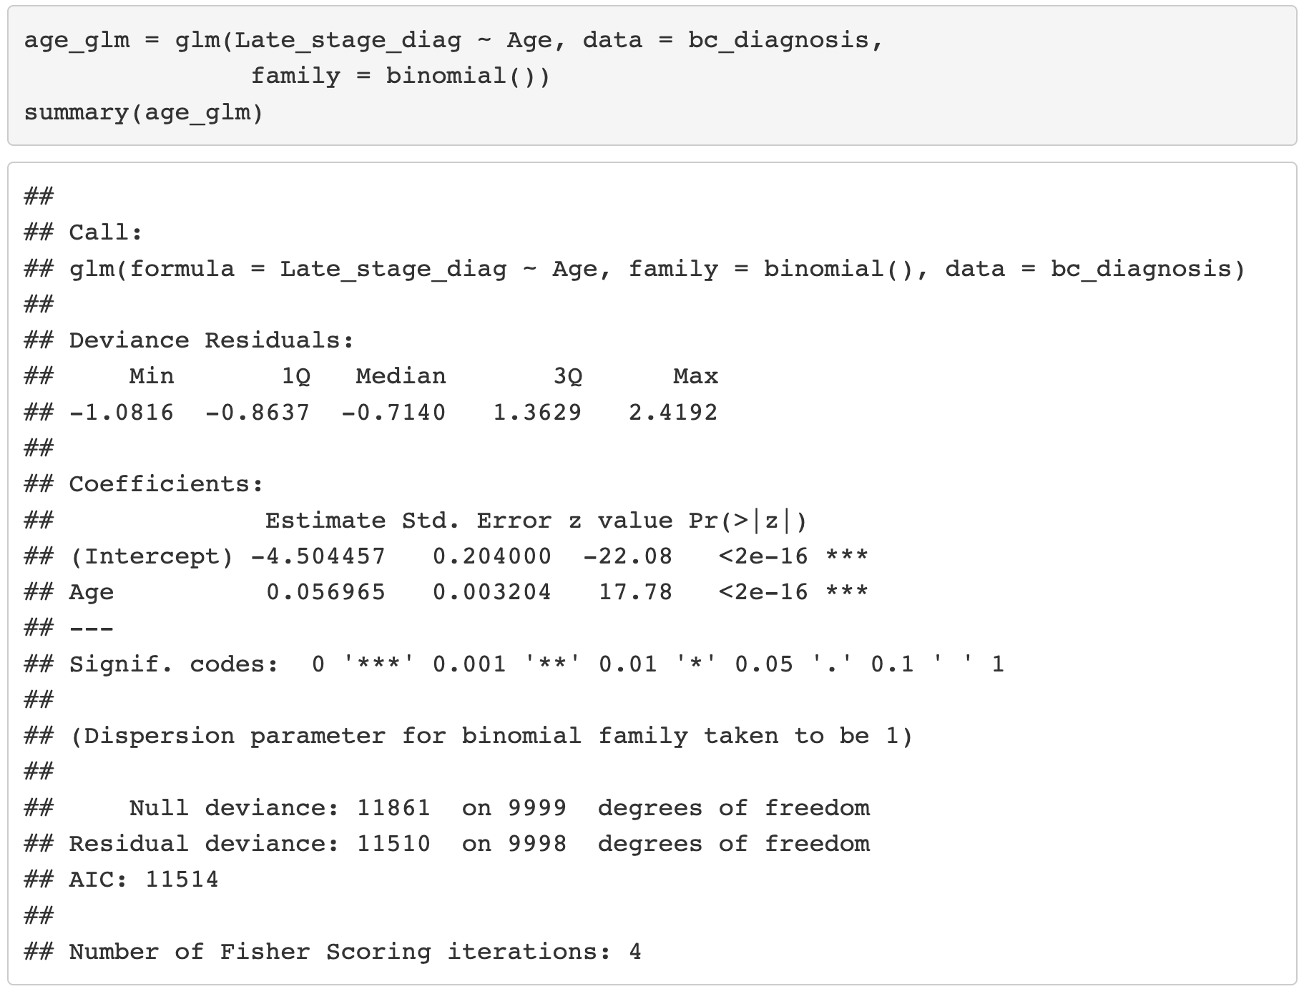
Example: Age and Late Stage Diagnosis (I)

Slide 63
Example: Age and Late Stage Diagnosis (I)

Slide 64
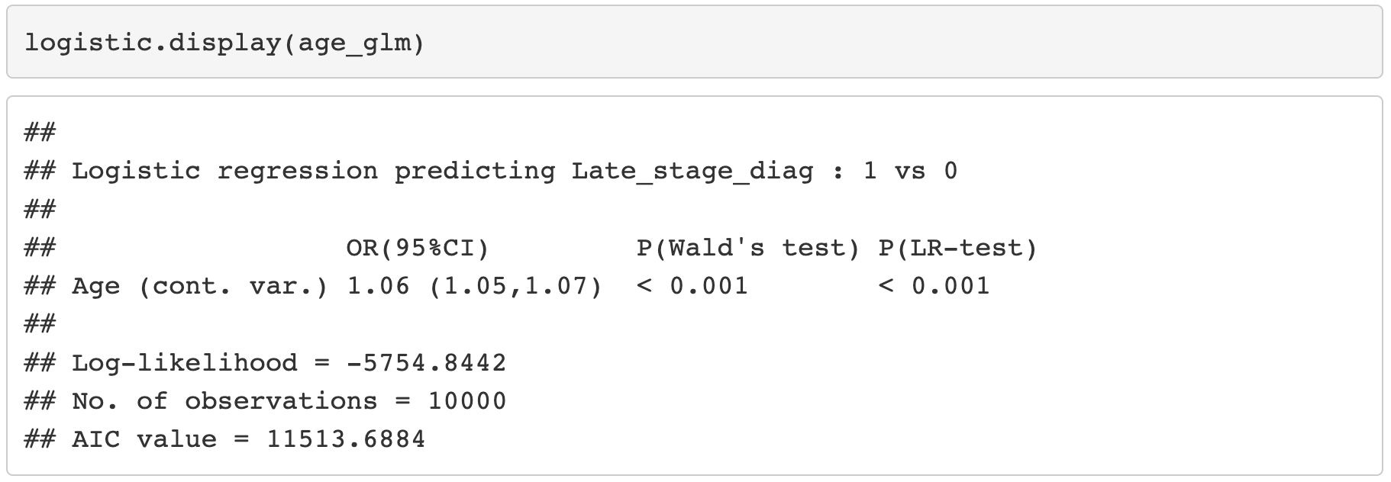
Example: Age and Late Stage Diagnosis (II)

Slide 65
Example: Age and Late Stage Diagnosis (II)

Slide 66
Poll Everywhere Question 6

Slide 67
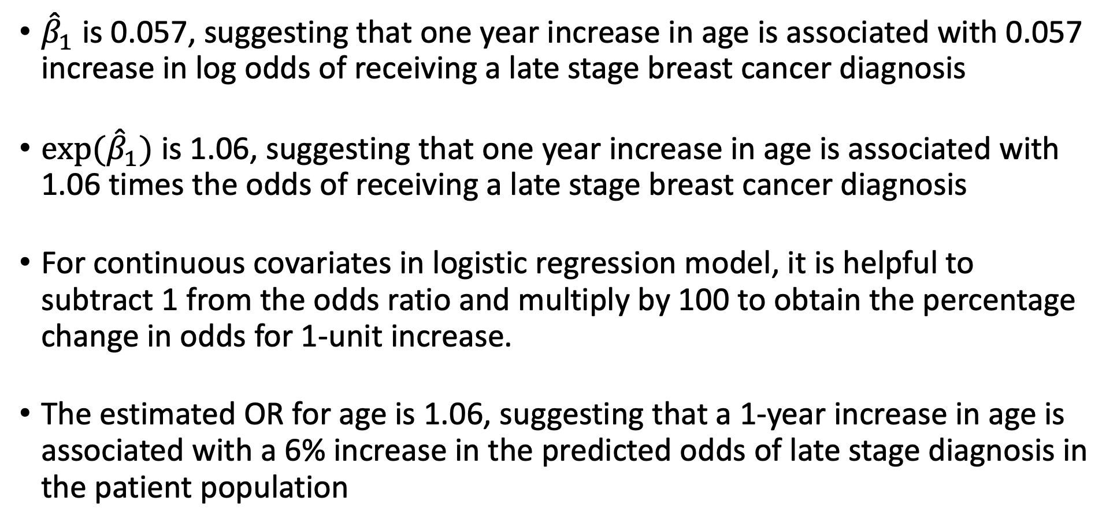
Example: Interpretation of Age Coefficient/OR (I)
${\hat{β}}_{1}$ is 0.057, suggesting that one year increase in age is associated with 0.057 increase in log odds of receiving a late stage breast cancer diagnosis
${exp⁡(\hat{β}}_{1})$ is 1.06, suggesting that one year increase in age is associated with 1.06 times the odds of receiving a late stage breast cancer diagnosis
For continuous covariates in logistic regression model, it is helpful to subtract 1 from the odds ratio and multiply by 100 to obtain the percentage change in odds for 1-unit increase.
The estimated OR for age is 1.06, suggesting that a 1-year increase in age is associated with a 6% increase in the predicted odds of late stage diagnosis in the patient population

Slide 68
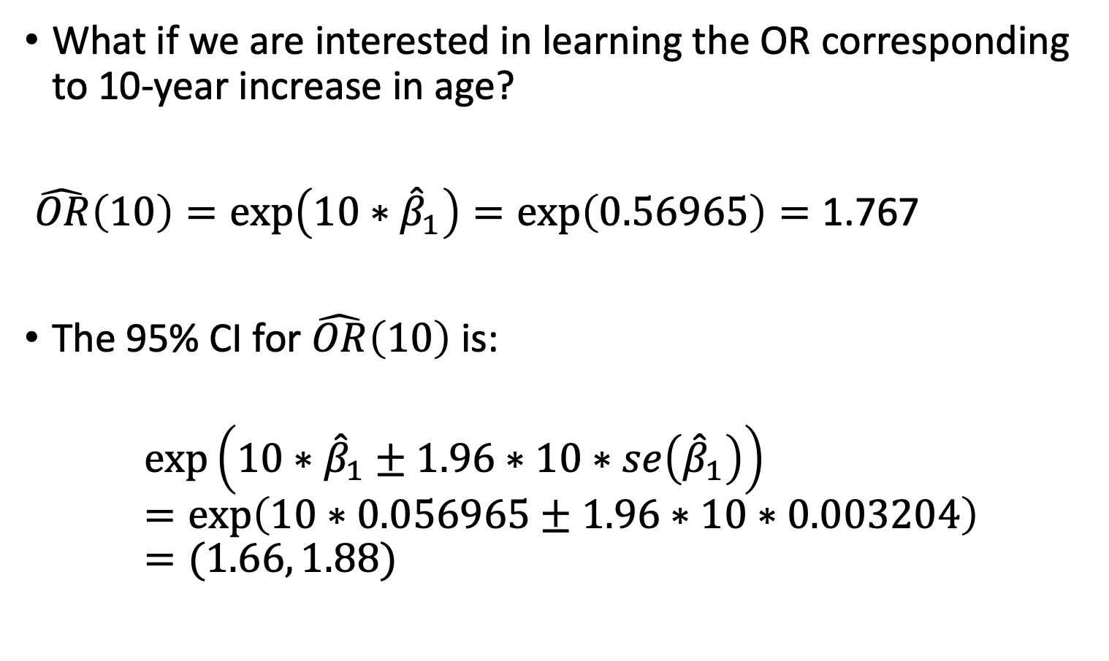
Example: Interpretation of Age Coefficient/OR (II)
What if we are interested in learning the OR corresponding to 10-year increase in age?
$\hat{OR}\left(10\right)=\exp\left(10∗{\hat{β}}_{1}\right)=\exp\left(0.56965\right)=\text{1.767}$
The 95% CI for $\hat{OR}\left(10\right)$ is:
$$\exp\left(10∗{\hat{β}}_{1}±1.96∗10∗se\left({\hat{β}}_{1}\right)\right)=\exp\left(10∗0.056965±1.96∗10∗0.003204\right)=(1.66, 1.88)$$

Slide 69
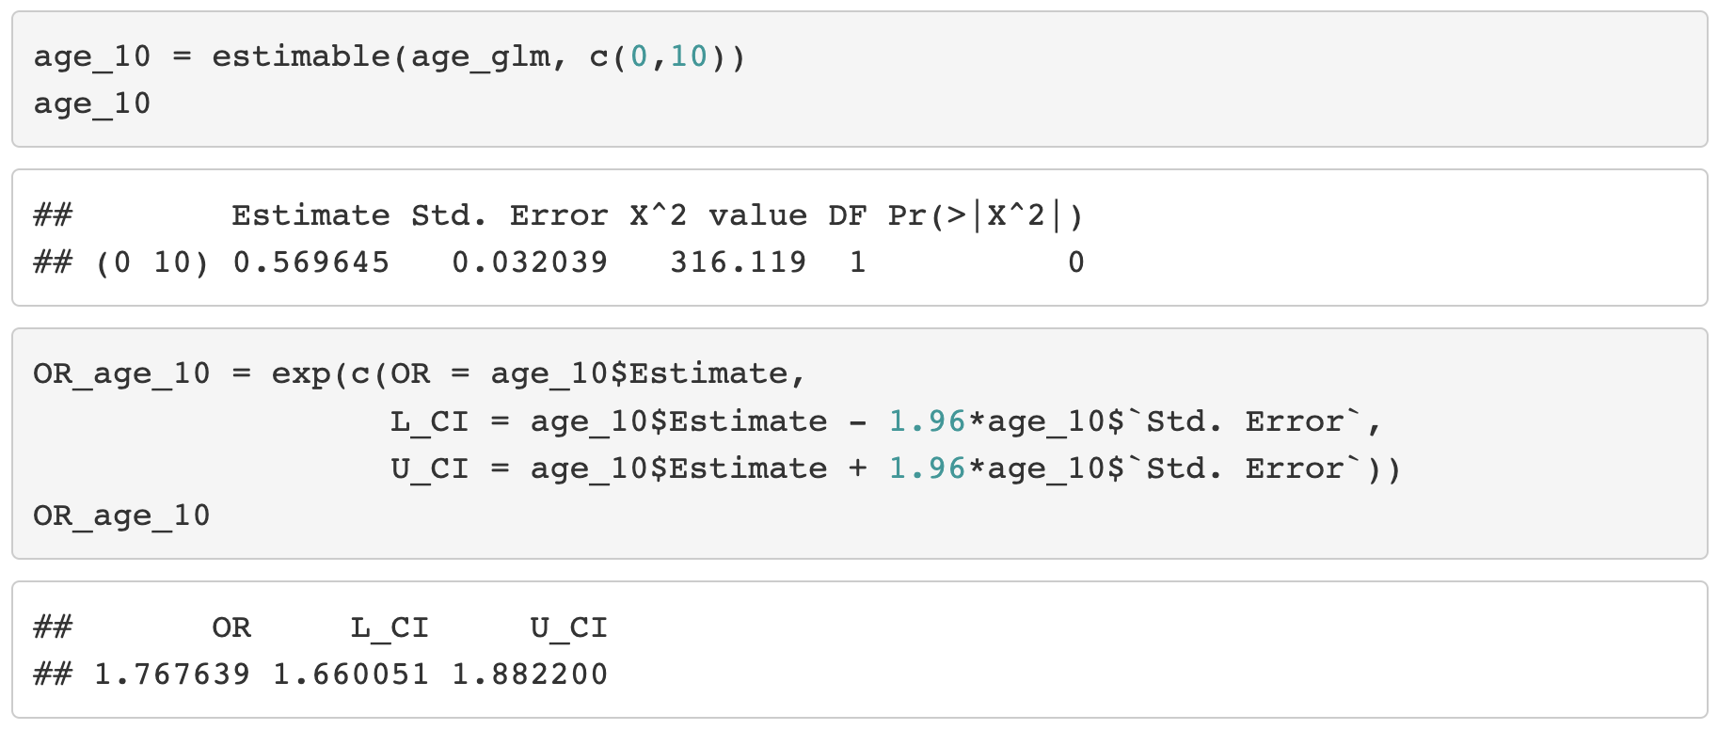
Example: Interpretation of Age Coefficient/OR (III)

Slide 70
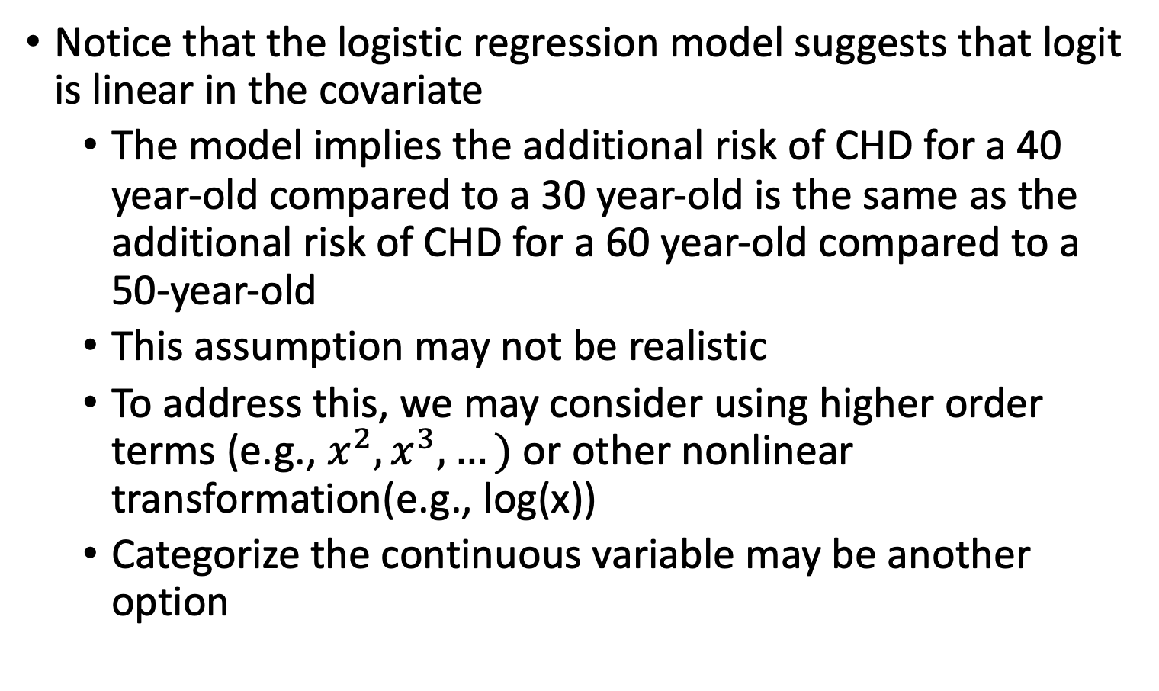
Last Note About Continuous Independent Variable
Notice that the logistic regression model suggests that logit is linear in the covariate
The model implies the additional risk of CHD for a 40 year-old compared to a 30 year-old is the same as the additional risk of CHD for a 60 year-old compared to a 50-year-old
This assumption may not be realistic
To address this, we may consider using higher order terms (e.g., $x^{2}, x^{3},…)$or other nonlinear transformation(e.g., log(x))
Categorize the continuous variable may be another option

Slide 71
Class 7 Learning Objective
Test the significance of estimated coefficients and create confidence interval for each using three tests (Finish up coding for Wald and LRT)
Predict the probability of “success” for an individual with specific covariate values
Interpret coefficient estimates for binary independent variables in simple logistic regression
Interpret coefficient estimates for categorial independent variables with multiple groups in simple logistic regression
Interpret coefficient estimates for continuous variables in simple logistic regression

Slide 72

Wrap-up
4-minute exit ticket
Links to further information on health disparities among different race and ethnicity groups
https://www.ncbi.nlm.nih.gov/pmc/articles/PMC6941147/
https://www.nature.com/articles/s41572-021-00258-1
Next class
Multiple logistic regression and coefficient interpretations!!
https://forms.office.com/r/Ri4ukc1XyH

